Slide 1
Fundamental Electronic Concepts
This is a quick review, or possibly a brief tutorial, depending on your background.

Slide 2


Fundamental Electronic Concepts
It is important to understand a couple of things.
First is the difference between a high and a low.
No, not that kind of High and low.

Slide 3
The microprocessor has several programmable input/output pins.
  That is you can program them to have high or low outputs and to change outputs when you want them to.
If a pin is set to put out 5 Volts… It is said to be in a High state.
If a pin is set to 0 Volts (or ground) it is said to be in a low state.

Slide 4
A high pin can supply electrical current to a ground, and a low pin can sink electrical current from a source.
A high pin can act as a source, and a low pin can act as a ground.

Slide 5
Light Emitting Diode (LED)
Lets review the LED.
It is like a check valve for electricity.
It lets electrical current flow in only one direction and blocks its flow in the other direction.
When electrical current flows through it, it glows.

Slide 6
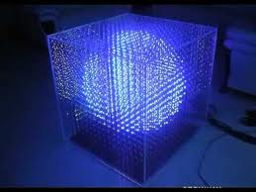
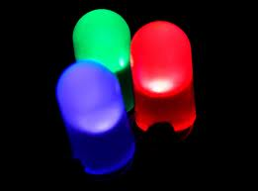
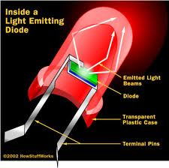
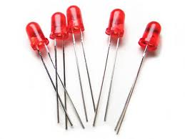
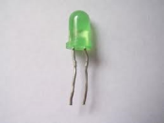

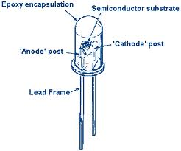
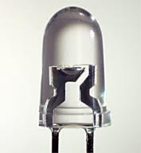
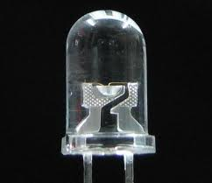
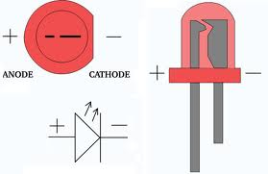
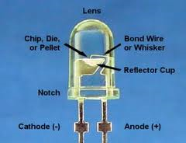
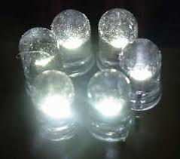

Slide 7
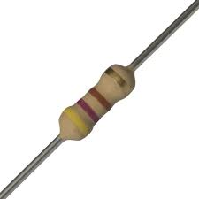

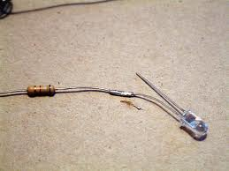
Rule of thumb.
  When using an LED, use a resistor of some value to limit the current.
LED’s are easily damaged and if you simply put a resistor in line with them then they are protected.
For 5 Volts… A good value to start with is a 100 Ohm Resistor.
If its to dim lowering the value will brighten the LED.

Slide 8
Anode / Cathode
An LED has two leads on it.
One is called the ANODE and connects to the Positive voltage source, and the other lead is the CATHODE.
The Cathode connects to the negative side of the voltage source.
When connected properly they will emit light.
The ANODE of a LED is longer than the cathode and the cathode side of the LED has a flat spot in the plastic case to identify it in the event the leads have been trimmed to the same length.

Slide 9
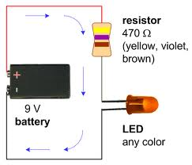
Try building this and playing with it
Note… This is a 9V battery, not a 5V source.
So we are using a 470 Ohm resistor
If the LED does not light up turn polarity of the battery around.

Slide 10

Pull UP & Pull DOWN
Pull up and pull down is really not a difficult concept, but necessary.
Lets imagine an input pin on a digital IC.
  If it is at 5V the IC registers it as a High.
  If it is at 0V it registers it as a low.
Simple enough.

Slide 11
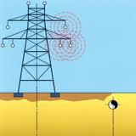
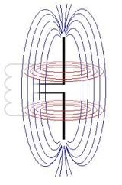
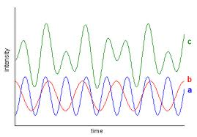
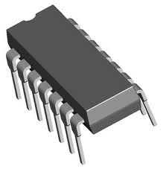
Sometimes the pins on an integrated circuit can act like an antenna.
Stray RF energy from appliances such as lighting, blenders, vacuum cleaners or cell phones a block away may induce a stray voltage on IC pins.
This may cause the chip to see the pin as a high when it is really suppose to be a low.
  Or even the other way around, seeing it as a low when it should be seeing a high.

Slide 12
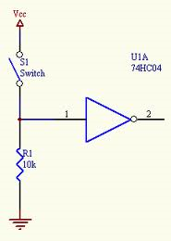
This is easily corrected.
If the pin should normally be in a low state and only go high when another part of the circuit applies 5V to it, then you can install a high value resistor (10,000 Ohms or more) that ties the pin to ground.
This resistor bleeds off any stray (small) voltages preventing the pin from looking like it is in a high state when it should be in a low one.
  The resistor does not affect the normal operation of the pin because it is a high value resistor.
  When 5V is applied, there is not enough current flowing through the resistor to cause any problems.
This is called a pull-down circuit.

Slide 13
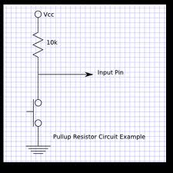
A Pull-up circuit does the same thing, but the High value resistor is connected the Vcc, or other form of voltage source, and holds the pin in a high state, but due to low current from the high value resistor being used it is easily taken to a low state.

Slide 14
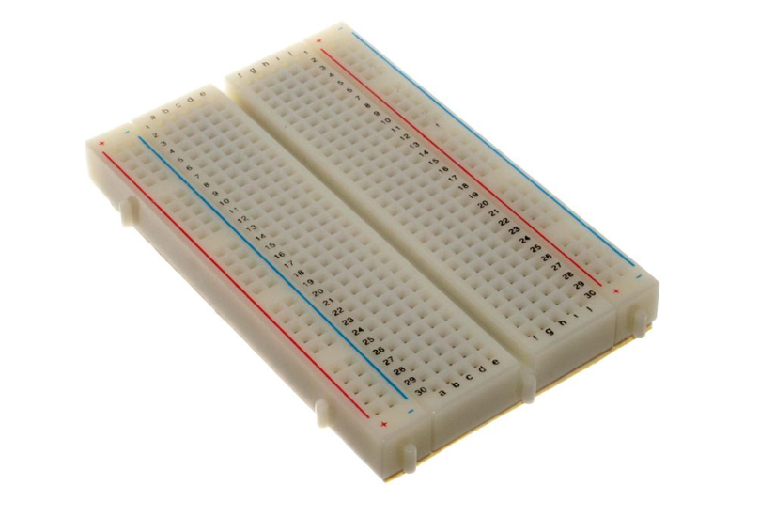
Solderless Breadboard
Also referred to as a prototype board, protoboard, plugboard or simply breadboard.
It is a construction base for electronic circuits.
Because the solderless breadboard does not require soldering, it is reusable, and thus can be used for temporary prototypes and experimenting with circuit design more easily.

Slide 15
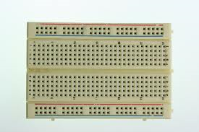
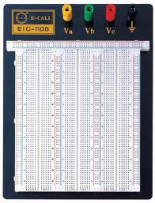
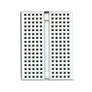
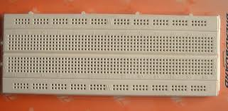

Slide 16
The holes in the board are interconnected to each other allowing components to be attached to one hole and linking it to other holes.
If you don’t know how to use a solderless breadboard, then get with the teacher to be shown how, nothing can substitute experience, and they really are simple devices that are easily grasped.
The next slide shows a diagram of the interconnections inside of a typical solderless Breadboard.

Slide 17
Solderless Breadboard interconnections

Slide 18
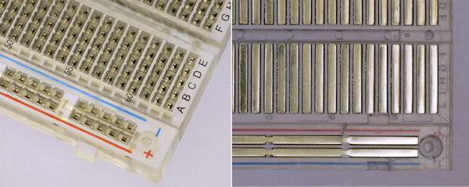
Solderless Breadboard flipped over and with the back removed so you can see the interconnections

Slide 19
Solderless Breadboard interconnections
Notice how there is a gap between the upper and the lower terminal strips.
This gap is sort of a valley that has its width set to accommodate the standard width of integrated circuits, or Microchips as they are also called.
This way a Duel Inline Pin microchip (DIP) may be inserted across the valley and allow for 4 tie points per pin on the chip.

Slide 20
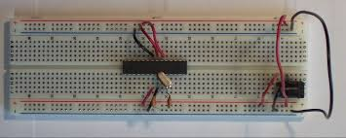
Example with a chip installed jumping the valley

Slide 21
Matrix
The solderless breadboards are laid out in a Matrix with Rows and columns.
The rows are lettered with the top ones above the valley being columns a-e and the ones below the valley being f-j.

Slide 22
Bus Bars
There are also two bus bars above the terminal strips and two below them.
Often these bus bars are coded as blue for negative, and Red for Positive, but sometimes they are not coded at all.

Slide 24
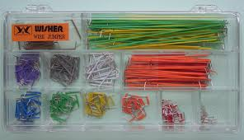
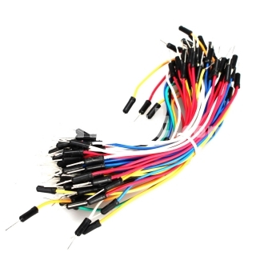
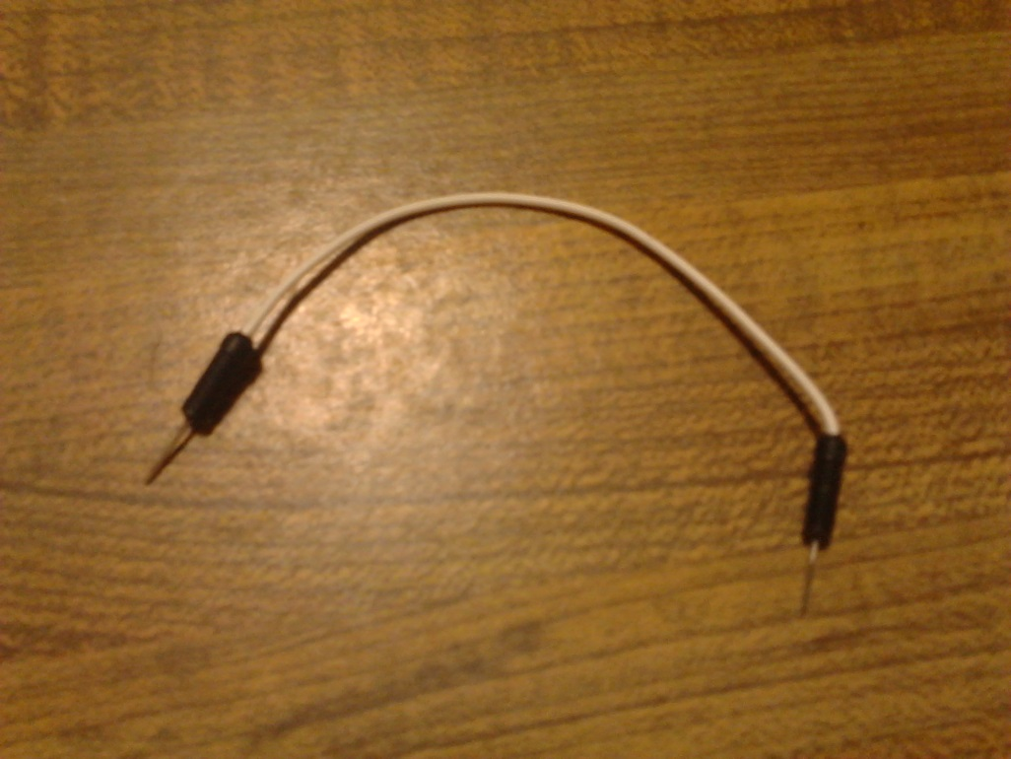
NOTE some jump wires, or some sort of small wire interconnects can be handy for use with solderless breadboards.
Just about any solid core wire will work so long as it isn’t too thick.
If the wire is too thick it will damage the breadboard.

