Slide 1
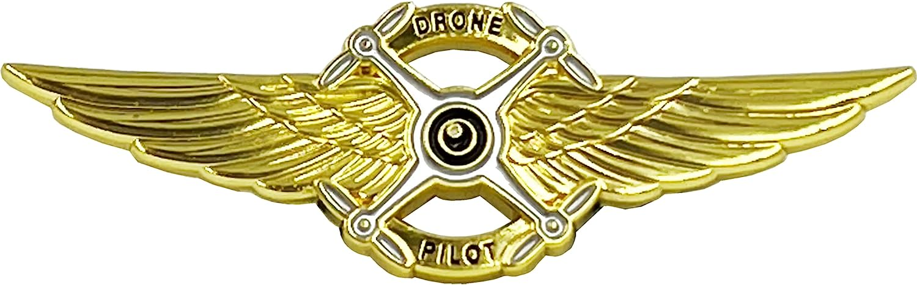
South Plains College
Drone Technicians
SUAS Pilots and Mechanics

Slide 2
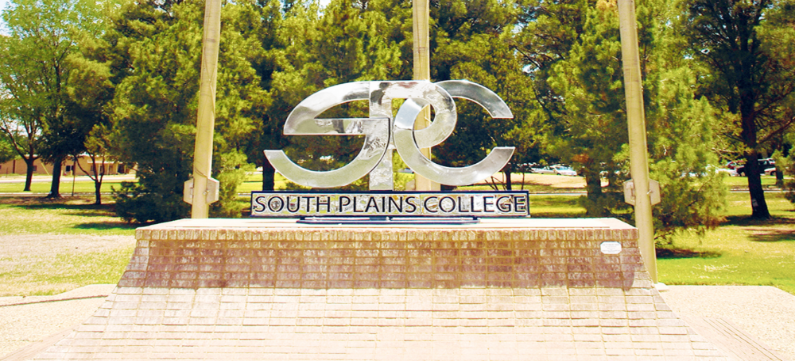
Who we are
South Plains College serves the greater South Plains area of Texas with innovative educational programs that span the arts and sciences, technical education, health sciences, continuing education and workforce development.
South Plains College purpose:
  To provide certificate and associate degree programs in career and technical education areas that equip students with the skills, attitudes, and aptitudes necessary for:
  gainful employment
  professional certification
  or advanced study.

Slide 3

Partnership
South Plains College is an active partner with the Matador UAS Consortium working to provide drone technology and transportation in the healthcare industry. “Equipping a modern profession of lifesavers in organ donation and Transplantation”.
The Matador UAS Consortium along with forthcoming drone industry, have found the ideal location: Reese Technology Center.
  It is a former Air force Base and is uniquely situated for Drone operation and coordination of multiple long range activities.
Furthermore; South Plains College maintains a campus at Reese where we will have the opportunity to expose our students to the realities of Live Drone missions.

Slide 4
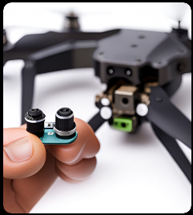
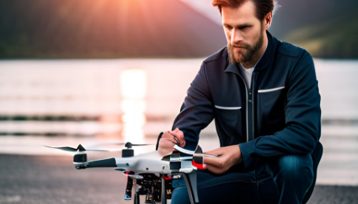
SPC is stepping up to the challenge of training future drone pilots and repair technicians.
As an active Matador UAS Consortium partner, South Plains College role is to provide associate of applied science degree graduates with Federal Aviation Administration (FAA) Part 107 Remote Pilot Certification and knowledge/skills in drone diagnostic and repair.
Therefore, starting fall 2023 South Plains College has revised the Industrial Manufacturing/Emerging Technologies curriculum to include:
  AIRP 1108 Drone Pilot Test Preparation, and
  AERM 2233 Drone Assembly and Rigging.

Slide 5
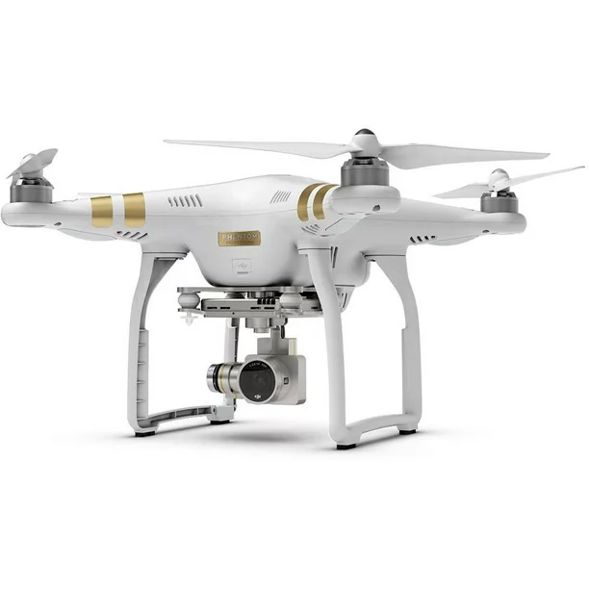
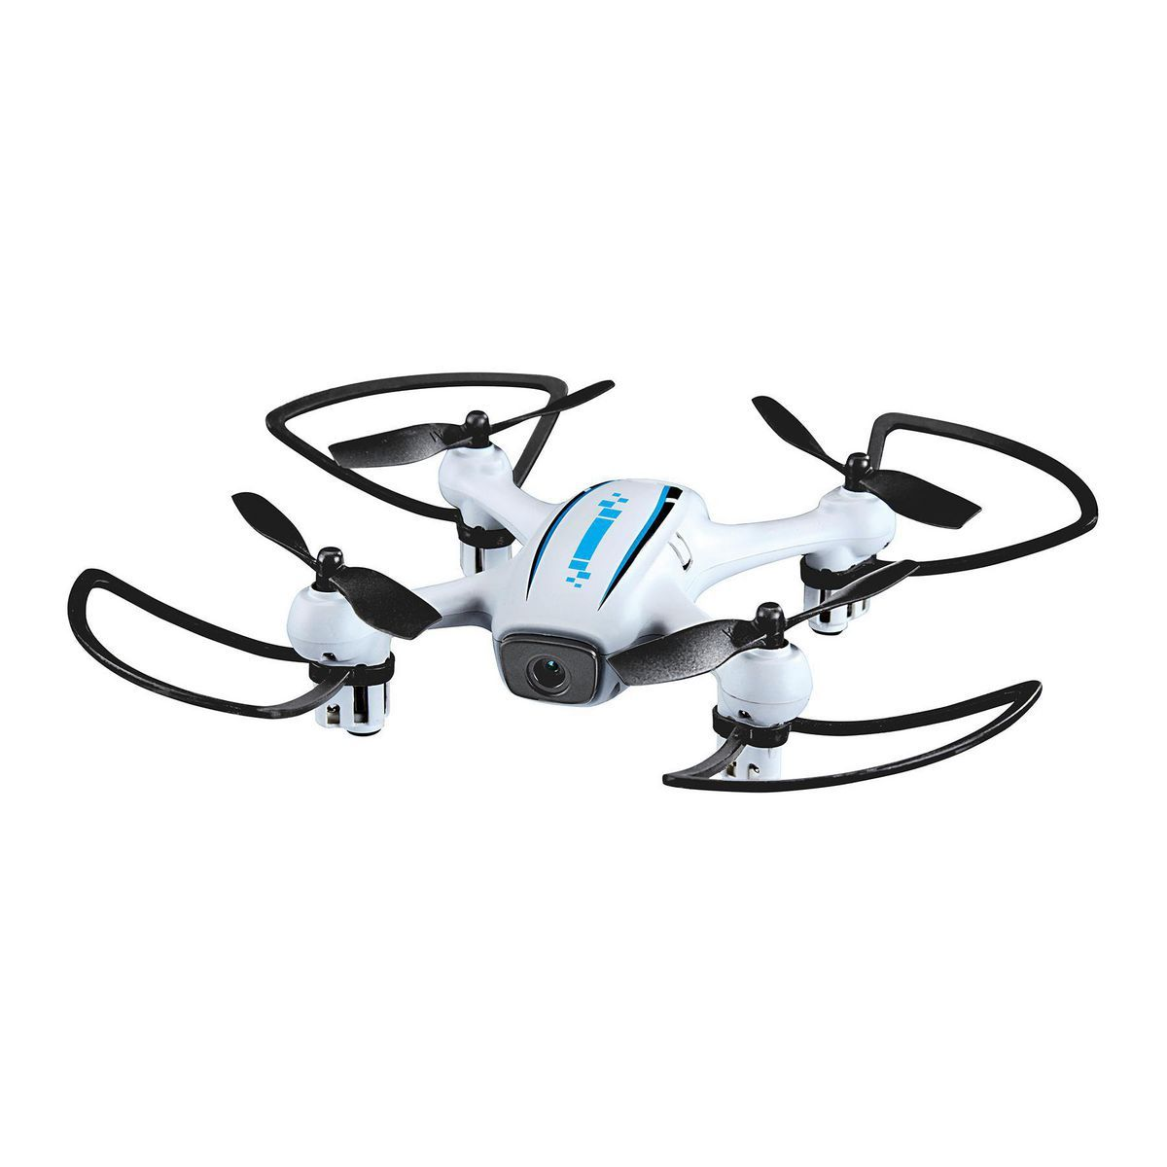
AIRP 1108 Drone Pilot Test Preparation
  In this class we will prepare the students to pass the FAA Part 107 exam.
    We will cover all subject mater through class discussion, Presentations/videos and practice testing.
  We will also teach the students on how to actually fly a drone.
    This will be done initially with small “Crash-able” drones until the students skill increases to the point they are capable of effectively controlling larger “Out-Door” capable units.

Slide 6
AERM 2233 Drone Assembly and Rigging
  In this class we will explore all Drone systems and construction techniques.
  We will first (as a class) construct a small Pre-designed and proven drone system giving the students a chance to learn all components and what they do.
    This will be broken up into several lesson items ranging from Motor types to selection of material for the airframe.
    This will allow us to explore options and design considerations as we construct.
    Including Flight Controller software (firmware) adjustments and tuning.
    This will lead into autonomous drone control and Waypoint flight paths, and Drone programming.

Slide 7
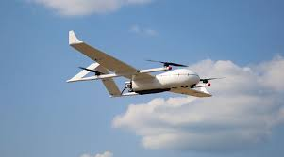
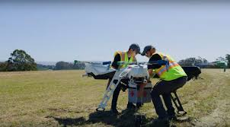
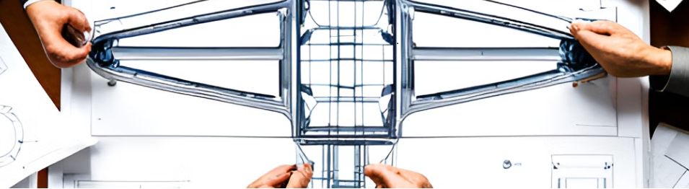
  Construction of a Large (50lb) drone.
    This Drone will incorporate Fiberglass, Carbon Fiber, Plastic, 3-D printing and sheet metal construction.
    Long range command and control architecture will be implemented in this project.
      NOTE only line of sight or visual observer implemented operations will be conducted until approved.

Slide 8

Command and Control
We intend on construction of a command and Control center.
This will be a small container (or room) to house up to 5 individuals at a time each fulfilling separate roles related to Beyond line of sight drone operation.
Pilot- Directly controlling the drone in flight.
First Officer/Copilot/Navigator – Working with the pilot monitoring flight conditions/weather and course navigation, while maintaining the ability to take over if needed.
Flight Engineer – Monitoring all onboard systems and communication link.
Payload Engineer- monitors, deploys or controls the payload.
Remote Pilot in command (Professor in charge)- monitors and instructs each student in the role they are fulfilling.

Slide 9
Various “other class” involvement
Pertinent lessons in Drone construction and technology already exist, or have been incorporated into other classes, so more knowledge, skill development and capability can be spread out through our program allowing us to involve other classes into these projects.
A few examples:
  The SCADA and Networking class is to be involved in Drone communication and control.
  MFG I and II will be involved in Fiberglass and Carbon Fiber construction as well as component design and 3-D printing.
  IT Essentials will install and maintain computer systems for the Command center.
These are, for the most part, all the same students at different stages in their academic career and training allowing new incoming students to be involved with those fixing to graduate.

Slide 10
Special Subjects to be covered throughout the program.
Instruct and exercise “hands-on” Carbon Fiber repair techniques relative to fixed-wing and rotary-wing (UAV) aircraft
Instruct and exercise “hands-on” Sheet Metal repair techniques relative to fixed-wing and rotary-wing (UAV) aircraft
Instruct and exercise “hands-on” Plastic repair techniques relative to fixed-wing and rotary-wing (UAV) aircraft
Instruct and exercise power, control, and communication techniques relative to fixed-wing and rotary-wing (UAV) aircraft

