Slide 1
The DC Motor

Slide 2
Six basic parts of a DC motor
  Axle
    Central pivot point of the rotor about which it turns.
  Stator
    The stator is the stationary part of the motor, Includes the motor casing, as well as two or more magnet pole pieces.
  Rotor (a.k.a., armature)
    The rotor rotates with respect to the stator.
    The rotor (Attached to the axle) consists of windings (generally on a core) that connect to the commutator (which is also connected to the rotor and axle and spins with them).
  Commutator
    The windings on the rotor are electrically connected to the commutator.
    The commutator is a mechanical switch what works on the rotation of the rotor connecting and un-connecting the magnetic windings of the rotor as it spins.
  Brushes
    Allows electrical contact through moving parts.
    A stationary component that presses against a moving commutator or slip-ring contact surface as it spins allowing transfer of electrical current to or from the moving part.
  Field magnets (One or more)
    In most common DC motors, the external magnetic field is produced by high-strength permanent magnets, but the field magnetism may be generated by electromagnets as well (as is the case for a starter on a car engine).

Slide 3
Electric motor, operation is based on simple electromagnetism.
A current-carrying conductor generates a magnetic field; when this is then placed in an external magnetic field, it will experience a force proportional to the current in the conductor, and to the strength of the external magnetic field.
As you are well aware of from playing with magnets as a kid, opposite (North and South) polarities attract, while like polarities (North and North, South and South) repel.
The internal configuration of a DC motor is designed to harness the magnetic interaction between a current-carrying conductor and an external magnetic field to generate rotational motion.
It's all about one magnet pulling (attracting) and pushing (repelling) another magnet.

Slide 4
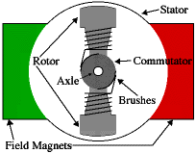
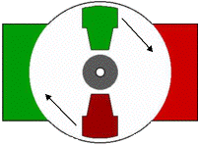
Let's start by looking at a simple 2-pole DC electric motor (here red represents a magnet or winding with a "North" polarization, while green represents a magnet or winding with a "South" polarization).

Slide 5
The geometry of the brushes, commutator contacts, and rotor windings are such that when power is applied, the polarities of the energized winding and the stator magnets are misaligned.
The rotor will rotate until it is almost aligned with the stator's field magnets.
As the rotor reaches alignment, the brushes move to the next commutator contacts, and energize the next winding driving it to continue rotating.

Slide 6
In real life, though, DC motors will always have more than two poles (three is a very common number).
In particular, this avoids "dead spots" in the commutator. You can imagine how with our example two-pole motor, if the rotor is exactly at the middle of its rotation (perfectly aligned with the field magnets), it will get "stuck" there.
Also, with a two-pole motor, there is a moment where the commutator shorts out the power supply (i.e., both brushes touch both commutator contacts simultaneously). This would be bad for the power supply, waste energy, and damage motor components as well.

Slide 7
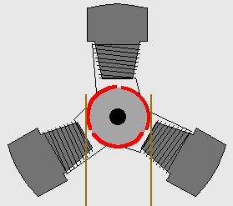
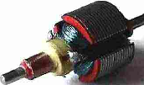
A three poll DC Motor

Slide 8
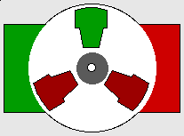
A three poll DC Motor

Slide 9
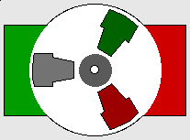
A three poll DC Motor

Slide 10
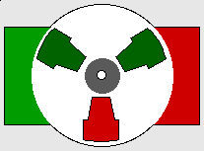
A three poll DC Motor

Slide 11
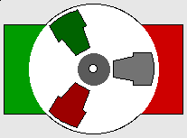
A three poll DC Motor

Slide 12
A three poll DC Motor

Slide 13
A three poll DC Motor

Slide 14
A three poll DC Motor

Slide 15
A three poll DC Motor

Slide 16
A three poll DC Motor

Slide 17
Class Project

Slide 18
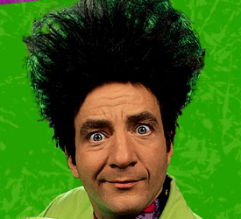
The Beakman Motor

Slide 19
PENCIL ALERT!!
One "D" cell battery
Transparent Tape
One Magnet (refrigerator magnets work fine).
3 feet of thin, enameled wire (#22)
Sandpaper or knife to scrape off enamel from wire
Two jumbo paper clips
A toilet paper tube
Wind the wire around the toilet paper tube about six times, leaving two-inch leads at opposite sides of the coil.
Wind each lead around the coil two times to hold the coil together.

Slide 20
Take your sandpaper, or knife, and sand all the enamel off one of the lead wires on the coil.
Next lay the other lead wire of your coil flat on a table and sand the TOP HALF of the enamel, leaving the enamel on the bottom half.
Carefully uncurl your jumbo paper clips and make a hook at the top end of each of them.
Now tape a paper clip to each end of the battery.
Stick the magnet on the side of the battery.
Hang the ends of the coil on the paper clip hooks.
Give the coil a little nudge to start it spinning.

Slide 21
If your motor doesn’t work
  Be sure the paper clips are in tight contact with the ends of the battery.
  Be sure that the sanded areas of the wire are shiny clean.
  Change the position of the magnet (You may have to hold it rather than sticking it to the battery).

Slide 22
"Bada-bing, bada-bang, bada-battery powered electric motor!"
"Electrical energy flows from the battery through the paper clip through the coil and back to the battery. That makes the coil a magnet -- an electromagnet. Our electromagnet and our refrigerator magnet repel (push) each other and that starts the coil turning."
"Remember how we scraped off all the enamel or insulation from one side of the wire, but only half of the insulation from the other side? That turns the wire into a kind of on/off switch.
  When it turns, the enamel side -- which doesn't conduct electricity -- touches the paper clip and shuts the current off.
  The coil coasts around until it is in the right position to turn on again. This happens over and over again, which keeps our very simple motor running."

Slide 23
