Slide 1
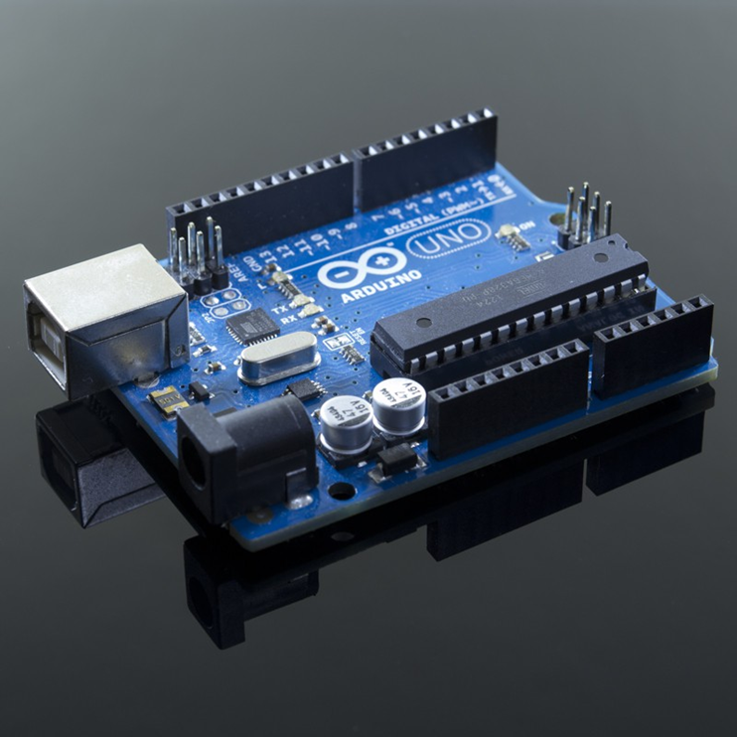
Arduino
The Basics

Slide 2
What is Arduino?
Basically it is a Microcontroller.
So what is a microcontroller you ask?
  Basically… an entire computer on a chip.
Well… sort of a basic stripped down bare bones computer.
  Not the type you are familiar with such as a desktop or laptop computer, but one that is intended for one specific application.

Slide 3

A microcontroller is a computer reserved to do just one thing (or a few things).
For example:
  You can have a computer dedicated to do nothing other than control the headlights in your car.
    It could have a light sensor to tell when it is dark enough that you should be using headlights
    and a sensor to tell when the car is actually running (as it wouldn’t be wise to turn the headlights on when the car is parked in the garage).

Slide 4
With such a computer built into a larger system dedicated to do such a simple task, there would be no need for it to have any extras.
  A keyboard, monitor or a mouse would be a waste of space and money.
There are lots of extra stuff in a computer that can be done away with to streamline this dedicated computer… So much so they can get it down to a single chip and a few extra support components.

Slide 5
Embedded System
A computer on a chip is its own independent system.
  A small complex system in its own right that is programed to do something inside of a larger system.
  A small dedicated computer used to control the headlights embedded into a larger system… That of a cars electrical system.
So in this respect we can define an Embedded system as a computer system with a dedicated function within a larger mechanical or electrical system.

Slide 6
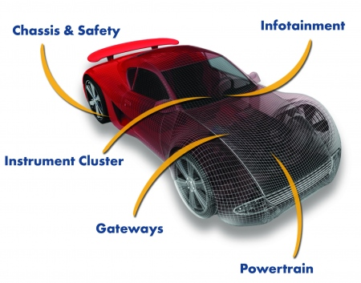
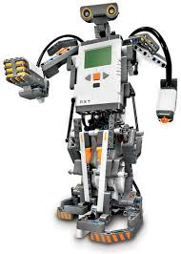
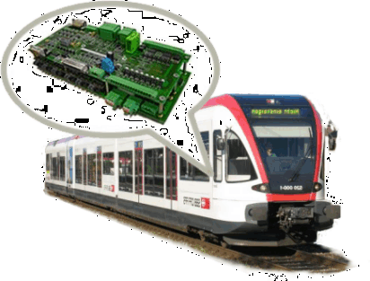

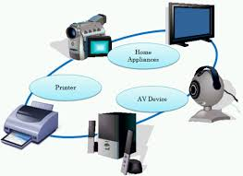
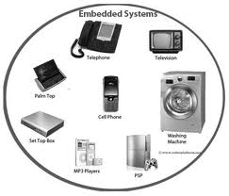
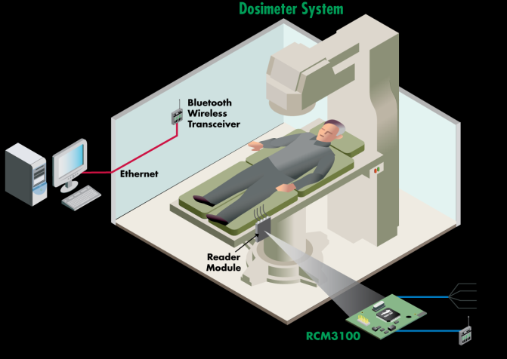
Embedded systems are very common.

Slide 7


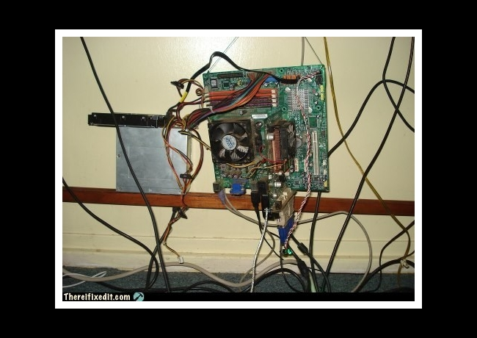
This stripped down Bare Bones computer tends to be a simple one, and as far as computers go… Can’t do much.
  At least as far as surfing the web or playing games with, but it is their simplicity that makes them so versatile, and with versatility, one finds power.

Slide 8
There are two parts to the Arduino
The Hardware
  The Arduino itself, and any other components and circuits that you will use along with it.
The Software
  The programs you will load onto the Arduino as well as the interface software you will use to load the programs with.
Lets look at the Hardware first.

Slide 9
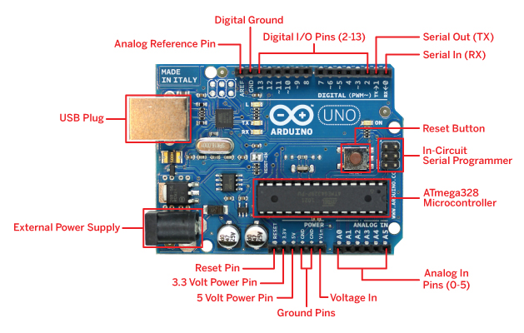
The Arduino UNO

Slide 10
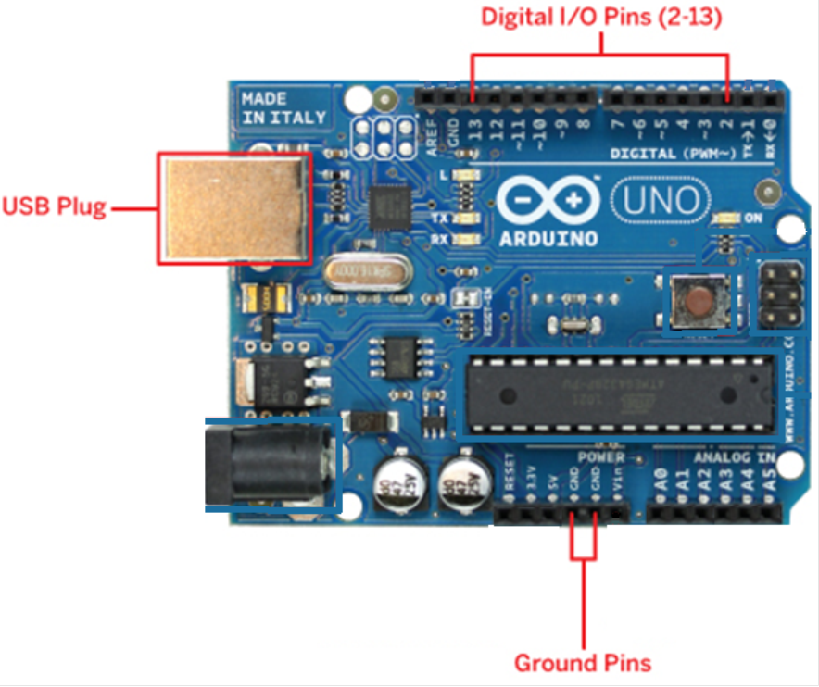
That is quite a lot, and we don’t really need to get into everything this thing can do.
Lets keep it simple and just use the following for now.

Slide 11
The USB Plug is easy.
  Just connect a USB cable to it and into your computer.
It supplies power from the computer to the Arduino and provides the communication path between the two as well.

Slide 12
There are a couple of ground pins that can be handy.

Slide 13
And last, but not least… The digital I/O Pins.

Slide 14
O.K. it is time to set up the Hardware.
Build the circuit on the following slide.
You will need:
  an LED
  A low value resistor (220 Ohm shown, but as low as 10 Ohms will work fine for this).
  A solderless breadboard
  A couple of wires long enough to make the connections.
When done you will essentially have digital pin 13 connected to the anode of an LED and the LED will be grounded through a low value resistor to the Arduino's ground pin.

Slide 16
Software
Next you need to get the software called the IDE Integrated Development Environment.
If it isn’t already installed on your PC.

Slide 17
Go to www.arduino.cc/en/Main/Software
Choose the correct version for your operating system such as (If you are running Windows)
Windows Installer, Or the Windows (ZIP file) if you are comfortable using Zip files, but the Windows installer exe is simpler.
  (They are located about halfway down the page).

Slide 18
Now find the file you just downloaded (Probably in your downloads folder).
It is called “arduino-1.6.3-windows.exe”
Double click on it and install it.

Slide 19
Once installation is complete plug the Arduino into the computer using a USB cable.
Windows should detect new hardware and ask to download drivers. Let it do so, and once done Activate the IDE software.
A desktop shortcut should have been created called Arduino.

Slide 20
Now… On the Desktop right click and select create a new shortcut.
A window will open asking what do you want to create a shortcut for?
Browse to the downloads directory and then on into the arduino-1.6.3-windows\arduino-1.6.3 directory,
Select the arduino.exe file and then hit finish.
A desktop shortcut should have been created called Arduino.

Slide 21
On the IDE software at the top is a drop down menu called Tools.
Select that and look for a sub menu called Ports.
Under that you should see at least one port listed for example “COM4 (Arduino Uno)”
Select that port (be sure there is a checkmark beside it)
  And the computer should now be able to talk to the Arduino.

Slide 22
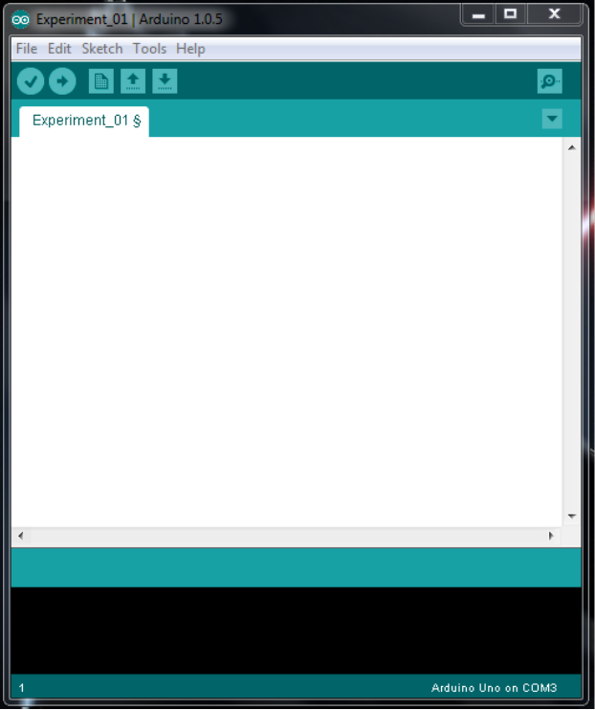
Once done you should have the following program loaded on your PC.
It is the IDE, and its sort of like notepad with a few extras.
Its where you write your programs, called “Scripts”, and they are written in a text format just like notepad.

Slide 23
Also, you can copy other Scripts (programs) from the web, or from notepad, or wherever else you find the text and paste it into this window.
Once the complete script is pasted, written, or opened into this window it can be automatically checked by the IDE to be sure there are no “Bugs” in the script by clicking on the check mark in a circle (Called Verify) at the upper left of the window.
  Any problems detected will be highlighted and a basic explanation of the issue will be posted at the bottom of the IDE.
If everything looks good, then by selecting the “Upload” button (the Arrow in a circle next to the Verify button) the script is compiled and sent to the Arduino via the USB cable.

Slide 24
Blinking LED
Lets load a program.
Open the IDE program and also open the text file “Blinking” using notepad.
Click anywhere inside the notepad text box to get the active curser.
Then select ctrl and the letter “a”.
  This will highlight everything inside of notepad.
Selecting ctrl and the letter “c” will copy everything that was highlighted to the clipboard.
Next click anywhere inside of the white field of the IDE so you can see the curser blinking inside of it.
Once the curser is in the IDE selecting ctrl and “v” will paste everything copied from the clipboard into the IDE.

Slide 25
Load the program
Selecting the upload button at the top left of the IDE (Arrow inside of a circle) will cause the program you just loaded into the IDE to be compiled and sent to the Arduino via the USB.
If there are no errors, and if you have the USB properly connected, and… if you have properly constructed the circuit from slide 15, then you should see the LED start to blink.

Slide 26
Play around a bit.
If you want the LED to blink faster or slower try adding, or subtracting from the number in the parentheses after the command delay.
It should be at a value of 1000 now and look something like this:
delay(1000);
  Also note… There are two delay commands in this program, play with them both.
If you make any changes you will have to re-upload the changed program to the Arduino.

