Slide 1
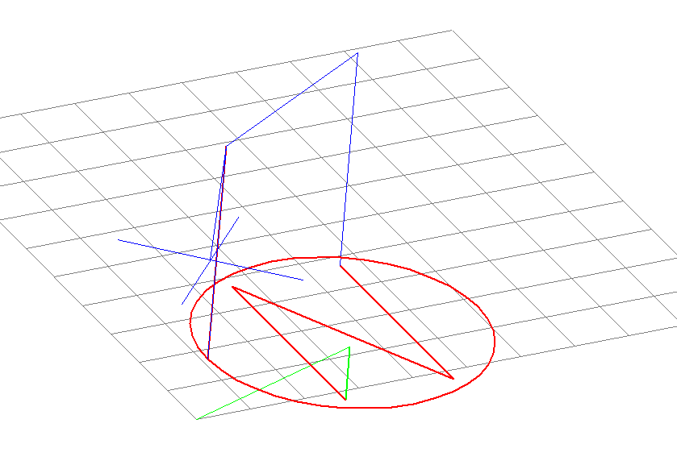
G-Code Brief
What it is and how to use it.

Slide 2

Automation History
Back in the 1960s, electronic automated controllers of various types were starting to be attached to different machines:
  such as printed circuit board photoplotters,
  Milling machines,
  lathes,
  automated assembly and pick and place devices
  as well as steel fabrication devices such as cutting machines that would cut and shape steel.
Every device used various commands and numerical values to control them.
So they became referred to as Numerically controlled or (NC) Machines to differentiate them from the older manually controlled ones.

Slide 3
Computers
As time went on computers were developed and adapted to replace the older controllers.
They were more versatile in handling of numerical commands and could easily handle lots of data input into them for controlling machines.
People started to referring to the NC machines as CNC machines for Computer Numerical Controlled machines.

Slide 4
Standardization
A problem arose early on when it was noticed that every machine was programmed differently from all the rest.
If a company had three types of machines they had to train their employees three different times.
In fact if they had different models of the same company’s machine they still had three different ways of programming them as there was no standard and each company basically started over reinventing the programming wheel for each new design they came up with.

Slide 5
The RS274D Standard
The Electronic Industries Alliance in the United states tried to set a standard for Numerical Control (NC) or Computer Numerical Control (CNC) machines.
They started working on this standard back in the 1960s when the problem first arose and due to technological improvements found it necessary to make many revisions each year.
They finally finished their final revision in 1980.
It was a good idea at its heart, and many used it, but everyone used a different revision, or interpreted it differently, or deviated from it in a few key areas.

Slide 6
Compatibility Issues
Unfortunately due to a lack of further development by the Alliance , the immense variety of machine tools, and little demand for interoperability, few adhered to the RS274D standard.
Some, but not all, CNC machine manufacturers attempted to overcome compatibility difficulties by standardizing on an already successful machine tool controller built by Fanuc.
The belief being that they all standardize on one company's interpretation and except that companies deviations from the standard essentially making them the new standard.

Slide 7
Unfortunately, Fanuc did not remain consistent with the RS274D Standard or even its own previous interpretations of it.
  Perhaps Fanuc did not want others to be compatible with them?
  Kind of like a software company that doesn’t want others being compatible with their product??
  Maybe???
Fanuc started producing controllers that varied from its previous models and essentially broke the deal.

Slide 8
Gerber Plot Files
Gerber Systems Corporation in conjunction with several other companies made an agreement amongst themselves on interoperability for their photoplotters and graphics software so they could do business together more easily.
  Unlike Fanuc, this small group relied on each other and wanted compatibility.
  At least a limited form of it between a few select partners.
They set their own standard, and published it as the GERBER FORMAT, Plot Data Format Reference Book .
The companies broke up, some sold out, others changed and merged, and got lost in the shuffle.
Gerber doesn’t even make photoplotters anymore.
But as the Gerber standard drifted around it was exposed to a lot of different companies and by 1990 was adopted by several other photoplotter vendors and also Computer-aided manufacturing tools for PCBs.
It became accepted as the as the new RS274X Standard.

Slide 9
It accidentally did for the world what the original RS247D standard failed to do for the US.
It became a de-facto standard for CNC and is informally called Gerber Code or…
G-code for short.

Slide 10
Differences remain
Like previous standards this one is still not adhered to closely, although they at least all similar now.
Most use a form of G-code, but like differences in English accent from state to state, or region to region, each CNC machine talks a slightly different dialect of G-Code.
What works on one machine still may not work on another.
Operators of any given controller must be aware of differences of each manufacturers' product and the many versions and variations of G-Code that exist.

Slide 11
Generating G-Code
There are programs that can generate G-Code for you from a picture of the item you want to mill or cut out.
AutoCAD is one example, and a host of other inexpensive programs the can be found.
Often the G-Code they generate is complex and long.
It is advantageous to be able to program directly in G-Code to make shorter simpler programs that accomplish the same thing.
If for no other reason than understanding; it is advantageous to be able to have a grasp of what the CAD or CAM software is giving you.

Slide 12
Writing a program
You write a G-Code program by typing lines of code into a text file… such as notepad in Windows.
This text file is saved as an NC file.
If say we right a program.
We want to call it the Circle-N then we can save it as CircleN.nc instead of CircleN.txt

Slide 13
Codes of G
The G-codes are the codes that set the conditions of the tool.
They tell the machine what it is that you want it to do, and they all start with the letter “G”.
G00 – move as fast as you can.
G01 – move, but not as fast as you can.
G02 – Start moving in a clockwise Arc.
G03 – Start moving in a counter clockwise Arc.

Slide 14
Speed
There are only two speed the CNC machine knows.
  Full speed
  The other speed
G00 = This code causes motion to occur at the maximum traverse rate (Full speed ahead or pedal to the metal).
G01 = The other speed
  Because you don’t want to go full speed all the time.
The other speed is defined by you.
Basically you tell it you want to go the other speed, then tell it what the other speed is by specifying the feed rate.

Slide 15
The Feed Rate
  You specify the feed rate using "F" and the desired speed you want it to travel in inches per minute.
    This is used for actual machining and Cutting.
  An Example would be G01 F15 (Moves at 15 IPM)
This command is basically saying:
  Go the other speed (Not as fast as you can), and by the way, the other speed is 15 IPM.
The feed rate is what is called “Modal” and because of that you don’t have to tell it the feed rate every time you give it a G01 command, only when you want the G01 speed to change.
  But you do have to tell it what “the other speed” is at least once.

Slide 16
Modal
Many codes are "Modal"
  Meaning that they stay in effect until they are cancelled or replaced by a contradictory code.
For example, once rapid feed is selected (G00) all tool movements would be rapid until told to go “the other speed”.
Likewise if “the other speed” is set at 15 inches per minute early in the program, then the machine will assume that is the speed you want every time you tell it G01.
  It will do this until you tell it G01 is a different speed by giving it a different “F” command

Slide 17
The interpreter is the program or the controller part of a CNC machine and is what runs the program.
  For example: KCam software from KellyWare.
  Or the computer program on a computer that is attached to a desktop CNC such as a Denford MICROMILL.
Blank lines are allowed and are ignored by the interpreter.
Different interpreters have different needs and expectations.
  for example some may be case insensitive (not caring if you use caps or not) while others error out if it isn’t all in caps.
It is usually safe to simply use caps for all G-Code.

Slide 18
More to the Code than “G”
Its Called G-Code, and uses the letter G as a command, but there are more code letters used in G-code programming than just G.
Lets explore a few basic commands

Slide 19
M-codes manage the machine.
T-codes are for tool-related codes.
  Tool refers to the “End Mills” or “Drill Bits” and such that lock into the spindle.
S and F are for tool-Speed and tool-Feed.
P-Codes set the Dwell time (a dwell of 5 seconds would be P5)

Slide 20
A few M-Code examples
M00 = Program Stop
  Stops the program where it is and holds.
M02 = Program End
  Stops the program and either resets to the beginning or simply goes to the very end skipping anything between it and the end of the program.
The spindle is the part of the machine that holds the cutting tool… With that in mind:
M03 = Engage Spindle CW
M04 = Engage Spindle CCW
M05 = Disengage, or stops the Spindle rotation.
M06 = Tool Change
M08 = Cutting tool Coolant Flood
M09 = Cutting tool Coolant Off

Slide 21
T-Codes
T-Codes are used to represent the tools used in the spindle.
Some CNC machines have multiple tools in an Automatic Tool Changer (ATC) and you can specify in the program which one to automatically load and use.
T-Codes are used in conjunction with M-Code 6 (M06).
The command being:
  M06 T1 (to select Tool 1)
  M06 T2 (to select Tool 2)
  Etc…

Slide 22
Axis
The X and Y coordinates are laid out in a grid fashion.
Pick a position to be the Zero point (Usually the lower Left corner of a grid).
  You gain a number in the X-direction (Left and Right direction) with every grid unit movement away from Zero you make.
The Y-direction (Front to back) is handled the same way as the X.
The Z-Direction is up and down.

Slide 23
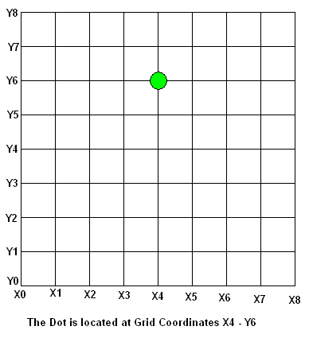

Slide 24

Absolute and Incremental can be tricky.
G90 = Sets Absolute mode
G91 = Sets Incremental Mode (Warning not recommended).
These commands set how the cutting bit moves around the grid.
Absolute mode causes the machine to remember where it is all the time.
  If its at the X10 location and you want it to move over to its X8 location you simply tell it to go to X8
Incremental mode causes it to forget its location as soon as it gets there and resets back to 0 after its move in complete.
  Basically when it is not moving it thinks its at the X0 Y0 Z0 location all the time.
  If its at the X10 location and you want it to move over to its X8 location you have to tell it to move X-2

Slide 25
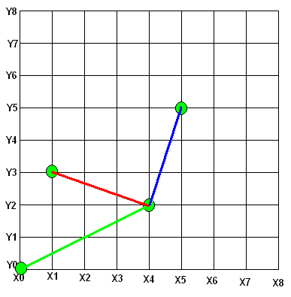
Absolute VS Incremental
If you start out at location X0,Y0 and move to location X4,Y2 the Dot will move to the location X4,Y2 regardless weather it was set in incremental or Absolute mode.
But the second move is where the difference shows up.
In absolute mode if you tell it to go to X1,Y3 it will move the X1,Y3 position (Shown in Red).
However; in Incremental mode a command of X1,Y3 will cause it to add 1X and 3Y to its current position and end up at location X5,Y5 (Shown in Blue).

Slide 26
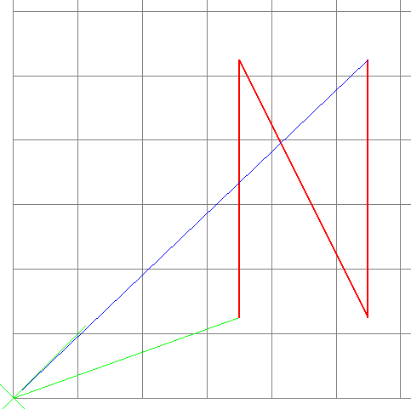
G-Code program to cut the letter “N”
G90 (Sets Absolute mode)
G01 F3 (Sets “the other speed” to 3 IPM)
M03 (Engage the spindle in a CW Direction)
G00 (Sets the speed to rapid)
X3.5 Y1.25 (Moves the spindle to the X3.5,Y1.25 position rapidly)
G01 Z-0.03 (Moves the spindle down to drill into the material 3/100th of an inch @ 3 IPM)
G01 F5 (Changes “the other speed to 5 IPM)
Y5.25 (Moves the tool “Cutting” up to the top of the “N” @ 5 IPM)
X5.5 Y1.25 (Moves the spindle Diagonally X5.5, Y1.25 position @ 5 IPM)
Y5.25 (Moves directly up “Cutting” to the X5.5,Y5.5 position)
  Note how if you don’t have to specify the X coordinate.
G00 Z3.0 (Pulls the spindle up to 3 inches above the material as fast as it can)
X0 Y0 (Moves the spindle to the X0,Y0 position as fast as it can)
M05 (Turns off the Spindle)
M02 (Ends the program)

Slide 27
Line Numbers
Line numbers Starting with the Letter “N” are ignored by the machine and are used only to keep the order of the program and for some programming commands.
They may be left off, or put in at the programmers discretion.
Be warned, some machines don’t accept line numbers.

Slide 28
G-Code “N” with Numbered lines
N001 G90
N002 G01 F3
N003 M03
N004 G00
N005 X3.5 Y1.25
N006 G01 Z-0.03
N007 G01 F5
N008 Y5.25
N009 X5.5 Y1.25
N010 Y5.25
N011 G00 Z3.0
N012 X0 Y0
N013 M05
N014 M02

Slide 29
The Block
The basic unit of G-Code is the ‘block‘.
  Each line of test in the program is one block.
Each block can contain one or more 'words‘.
  A single letter, describing a setting to be made, or a function to be performed, followed by a numeric field, supplying a value to that function.
  Example G00 or T6 or M03
A permissible block of input is currently restricted to a maximum of 256 characters.

Slide 30
A block example
N0001 G00 X123.05
This block is constructed using three words, N0001, G00, and X123.05.
In essence:
  The N0001 is a word that numbers the line.
  The G00 word tells the machine to get to its destination as quickly as it can.
  The final position of the X axis is to be 123.05.

Slide 31
Axis Words
We have already seen examples of axis words.
An X word would be X10.5 which by itself indicates the X axis should move to a position of 10.5 units.
X - Primary Linear Axis
Y - Primary Linear Axis
Z - Primary Linear Axis (Almost Always Up and Down)

Slide 32
While a block of code has a specific order of execution, it must be considered to be a single command.
All of the words within a block combine to produce a single set of actions.
This may be very different from the actions assigned to the same words were they placed in separate blocks.
A simple example using axis words should illustrate this point.

Slide 33
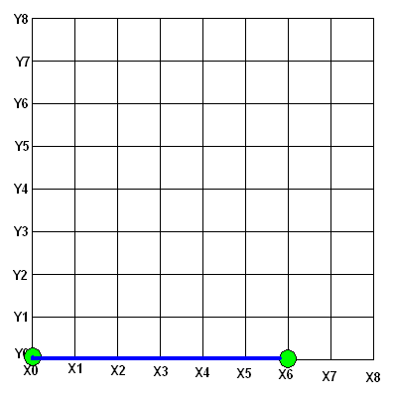
X6

Slide 34
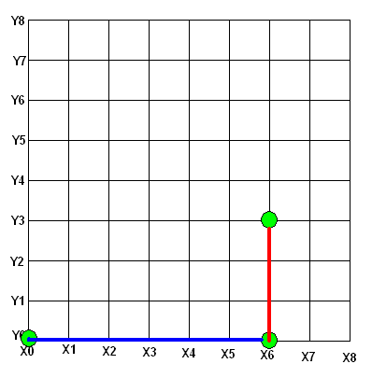
Y3

Slide 35
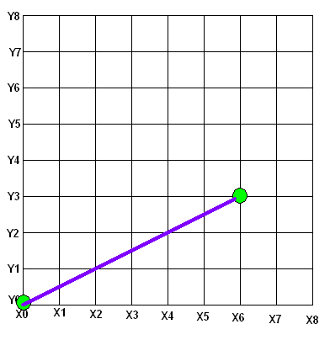
X6 Y3
Moves on a single line from current X, Y location to X6 Y3.

Slide 36
Tool Path considerations
The final position of the tool ends up being X6 Y3 using either individual moves of X6 first followed by one of Y3, or a combination move of X6 Y3.
The first set of blocks might be executed in sequence to move the tool around an obstacle while the path of the tool for the combined block might run it into the part or the fixture.

Slide 37

Arcs
G02 = Executes an arc in a clockwise direction.
G03 = Executes an arc in a counter-clockwise direction.
When coding circular moves, you must specify where the machine must go and where the center of the arc is by specifying the center of the arc with I and J words.
I is the incremental distance from the X starting point to the X coordinate of the center of the arc.
J is the incremental distance from the Y starting point to the Y coordinate of the center of the arc.

Slide 38
Lets break this down a bit.
G2 X2.0 Y3.5 I2.5 J0.0
G02 comes first telling the machine to do an arc in the clockwise direction.
  It doesn’t need to be told where to start from as it assumes it is already at the starting location.
X2.0 Y3.5 are the stopping coordinates.
  Basically tell it where to go to while making an arc.
I2.5 J0.0 Are used to tell where the center of the arc is.
  X and Y are already used so I and J are used here in their place.

Slide 39
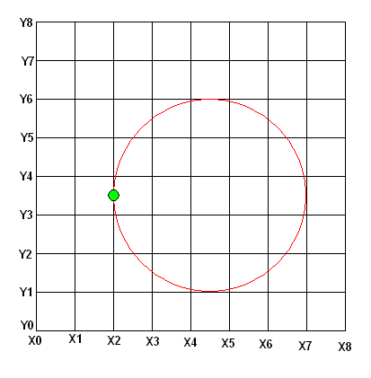
G02 X2.0 Y3.5 I2.5 J0.0
Grid location where it ends
Number of units center is from starting X location
Number of units center is from starting Y location
Clockwise Ark

Slide 40
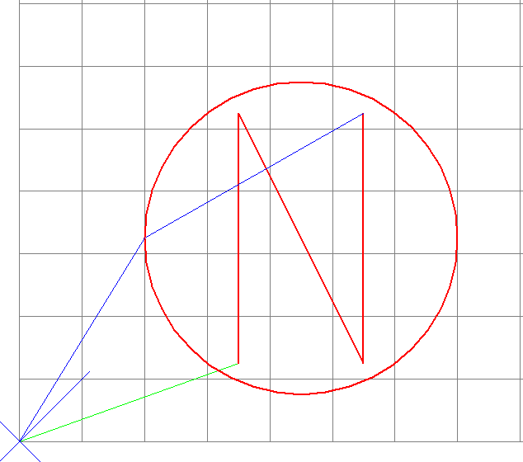
The Circle “N” Program in G-Code
G90
G01 F3
M03
G00
X3.5 Y1.25
G01 Z-0.03
Y5.25
X5.5 Y1.25
Y5.25
G00 Z3.0
X2 Y3.25
G01 Z-0.03
G02 X2.0 Y3.25 I2.5 J-0.0
G00 Z3
X0 Y0
M05
M02

Slide 41
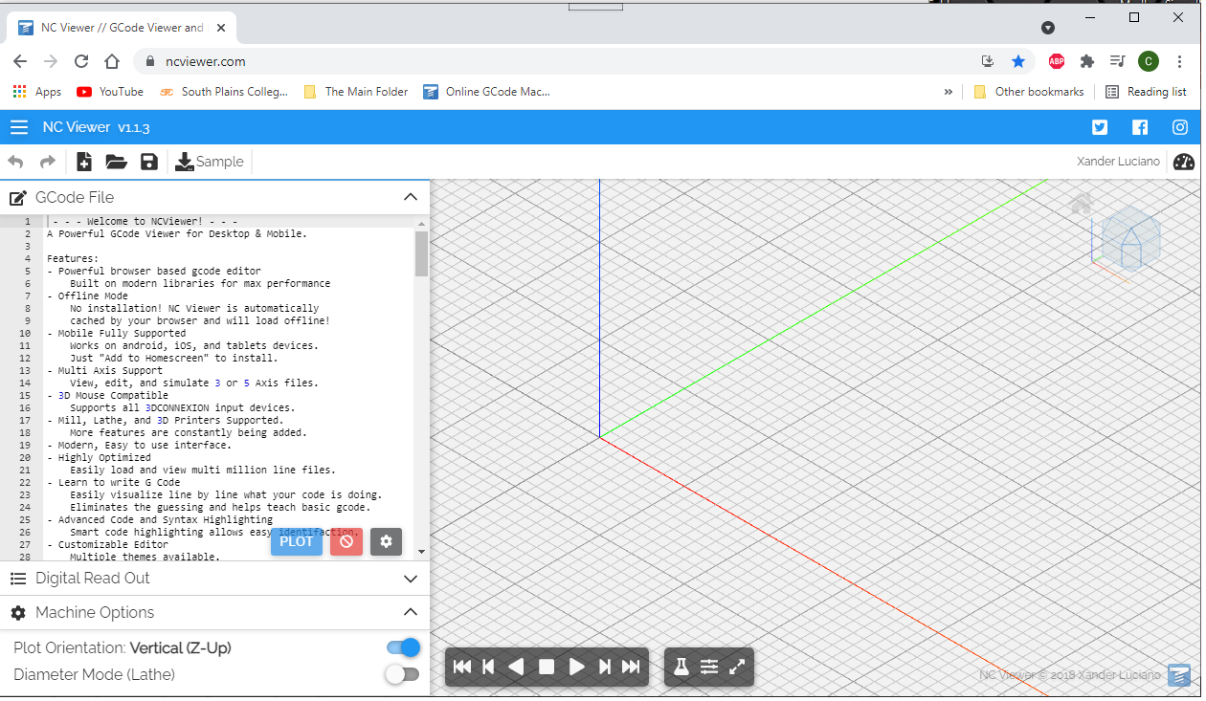
The Circle “N” Program in G-Code
https://ncviewer.com/

