Slide 1
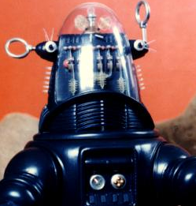
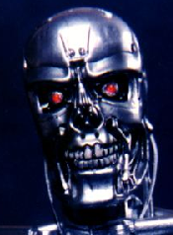
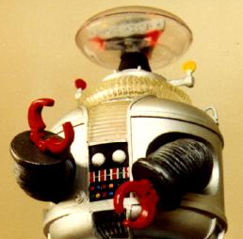
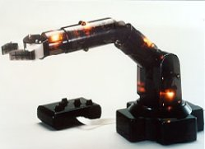
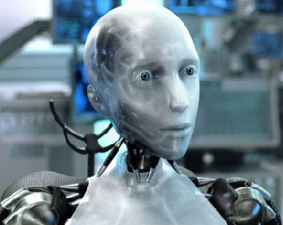
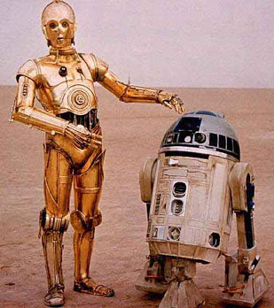
Robotics
What it is and what it is not

Slide 2
The undefined definition
A robot is a mechanical or virtual artificial agent.
In practice, it is usually an electro-mechanical system which, by its appearance or movements, conveys a sense that it has intent, or agency of its own.

Slide 3
The word robot can refer to both physical robots and virtual software agents, but the latter are usually referred to as bots.
There are many variations in definitions of what exactly is a robot.
However, there is no universally agreed upon definition as to which machines qualify as robots, and which are just machines.

Slide 4
Official definitions and classifications of robots
Because of the many variations in definitions it is sometimes difficult to compare numbers of robots in different countries.
To try to provide a universally acceptable definition, the ISO gives a definition of robot as:
“An automatically controlled, reprogrammable, multipurpose, manipulator programmable in three or more axes, which may be either fixed in place or mobile for use in industrial automation applications."
It was hoped that this definition would be used when comparing the number of robots in each country.

Slide 5
In spite of the ISO definition, countries, such as the USA and Japan maintain different definitions of robots.
Japan, for example, lists very many robots partly because more machines are counted as robots under their definition than under the US definition.

Slide 6
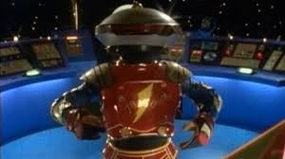
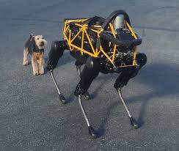
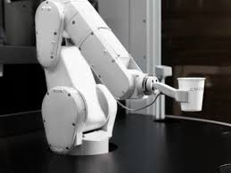
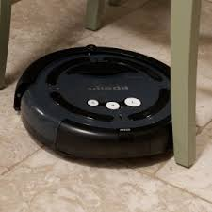
Physical Agency
For many laymen, if a machine looks anthropomorphic
    (Having the form of a man )
or zoomorphic
    (Having the form of an animal),
Especially if it is limb-like
    Such as a simple robot arm,
Or can move around
It would be called a robot
  regardless of its control architecture.

Slide 7
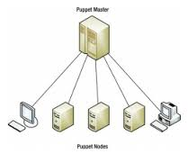
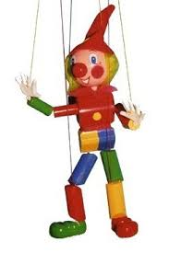
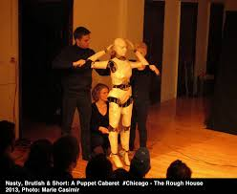
* A Brief definition
The control architecture is what controls the device, be it strings on a puppet or a sophisticated computer controlled electronic timing circuit.

Slide 8
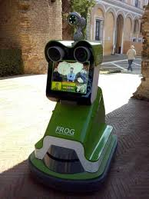
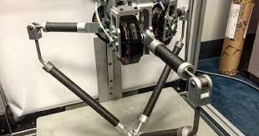
On the other hand
If a machine doesn’t look like a classic robot, even though it has a sophisticated control architecture and can meet most if not all of the usual definitions it may still not be referred to as a Robot.

Slide 9
Even if the following examples used the same control architecture:
A player piano is rarely characterized as a robot.
A factory automation arm is almost always characterized as a robot or an industrial robot.
An autonomous or self guided wheeled or tracked device or vehicle, is almost always characterized as a robot.
A zoomorphic mechanical toy, like “Roboraptor”, is usually characterized as a robot.
A humanoid, like “ASIMO”, is almost always characterized as a robot or a service robot.

Slide 10
a CNC milling machine is occasionally characterized as a robot.
Interestingly, while a 3-axis CNC milling machine may have an identical control system to a robot arm, it is the arm which is almost always called a robot, while the CNC machine is usually just a machine.

Slide 11
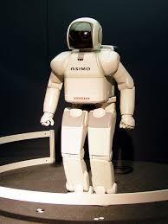
There is a limit
Simply being anthropomorphic is not sufficient for something to be called a robot.
At the very least a robot must do something, whether it is useful work or not.
For example, a dog's rubber chew toy, shaped like ASIMO, would not be considered a robot, but rather a toy, or item.

Slide 12
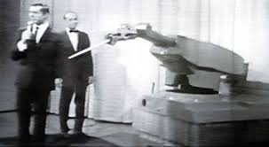
There is no one definition of robot which satisfies everyone, and many people have their own.
For example, Joseph Engelberger, a pioneer in industrial robotics, once remarked:
    "I can't define a robot, but I know one when I see one."

Slide 13
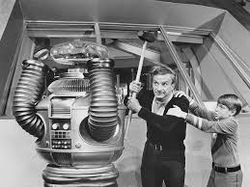

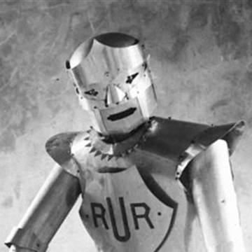
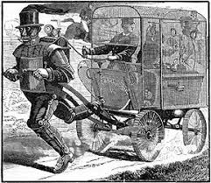
So where did this all start?

Slide 14
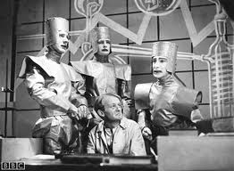
Rossum's Universal Robots
The word robot was introduced by Czech writer Karel Čapek in his play R.U.R. (Rossum's Universal Robots), which premiered in 1921.

Slide 15
The play begins in a factory that makes 'artificial people'
  They are called robots, but are closer to the modern idea of androids or even clones.
They are creatures who can be mistaken for humans, and they can plainly think for themselves.
The word robot comes from the word “robota” meaning literally labor, work, drudgery or hard work.

Slide 16
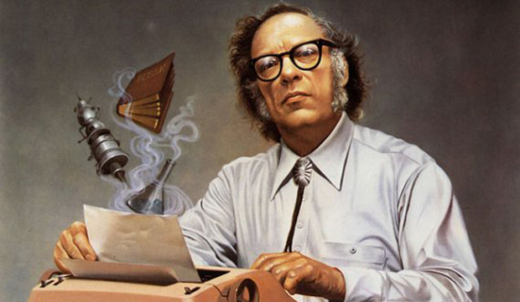
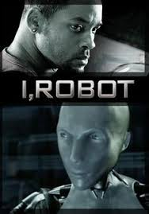
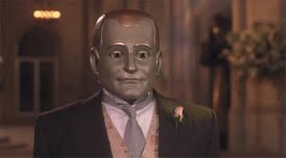
The Three Laws of Robotics
In science fiction, the Three Laws of Robotics are a set of three rules written by Isaac Asimov, which almost all robots appearing in his fiction must obey.

Slide 17
1 A robot may not injure a human being or, through inaction, allow a human being to come to harm.
2 A robot must obey orders given to it by human beings, except where such orders would conflict with the First Law.
3 A robot must protect its own existence as long as such protection does not conflict with the First or Second Law.

Slide 18
Of what importance?
According to the Oxford English Dictionary, the first passage in Asimov's short story "Liar!" (1941) that also mentions the First Law, is the earliest recorded use of the word ”Robotics”.
Asimov was not initially aware of this;
  he assumed the word already existed…
    like mechanics or hydraulics.

Slide 19
Teleoperators, Androids, Artificial Intelligence, Automatons, Clones and Cyborgs
You should now have a basic idea as to what a robot is, but what about the other stuff?
There is lots of “Other Stuff” out there, mainly in Sci-Fi and fantasy entertainment, but surprisingly most of it is based, at least in part, in reality.
Lets briefly explore some of them.

Slide 20
Teleoperators
Most often referred to as Remote Controlled Robots, Despite being technically inaccurate… convention has won out and that is what they have come to be known as.
Teleoperators are remote control devices such as a bomb disposal crawler controlled at a distance by a human operator.
The control signals may be sent by wire, fiber optics, or radio signal.
Teleoperators are quite useful in hazardous locations such as underwater or inside pipes and in environments that have chemical and radioactive danger.

Slide 21
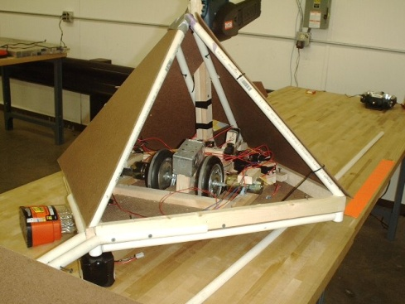
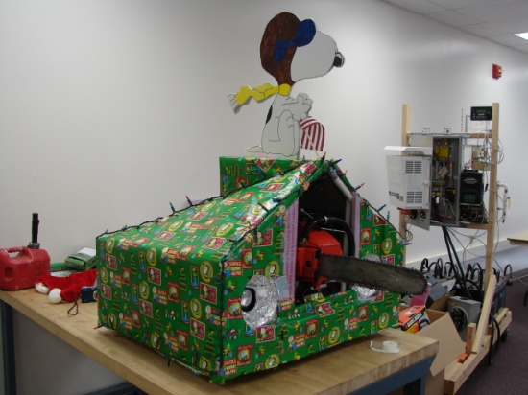
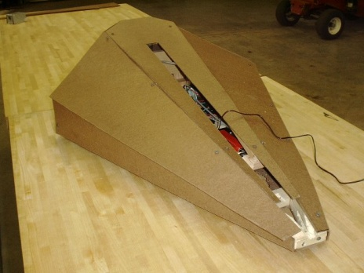
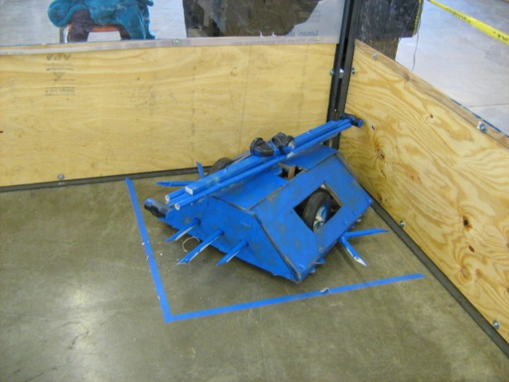
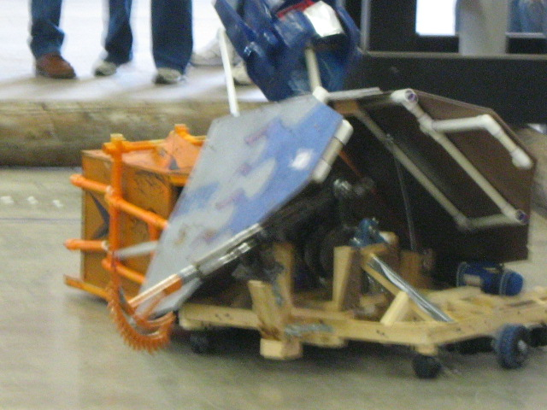
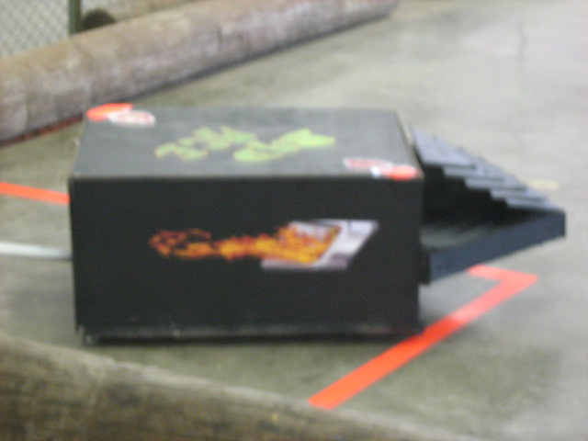
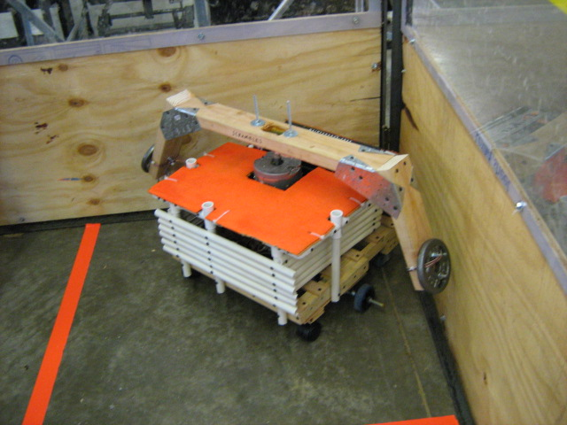
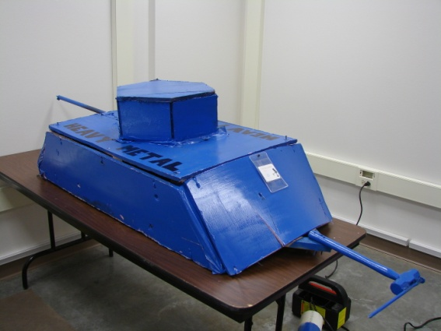
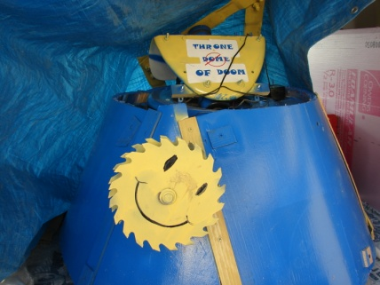
A Battle Bot is an example of a Teleoperator.

Slide 22
Automatons “A-tom-a-tons”
(animatronics)
A machine or control mechanism designed to follow automatically a predetermined sequence of operations or respond to encoded instructions without deviation.
Sometimes referred to as robots, but technically that is inappropriate.
A washing machine can be seen as a “non- anthropomorphic” form of automaton since it automatically sequences through a number of steps such as wash, rinse, spin dry, etc.
A coin operated drink machine is another example of an automaton.

Slide 23
Both machines can be altered to:
  skip a step
  have an additional step included
  or the steps themselves can be altered to take different paths or take different times to complete
  Require more money to function
but all these alterations happen in a very limited way and aren’t something any reasonable person would consider reprogramming…
Maybe re-sequencing would be a more appropriate term.

Slide 24
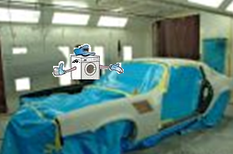
A washing machine can be changed from delicates to extra heavy… But regardless to what buttons you select or what dials you rotate it will never Paint a car.

Slide 25
Despite the complexity of the mechanism driving the device, in the end, it often employs simple logic and/or clockwork type systems to run.
Its actions are often rigidly locked and not easily changed.
A final example could be an animal band used for entertainment at children orientated business such as Chucky Cheeses Pizza.
The songs can be replaced and the movements can be altered, but they will not easily be made to do anything other than sing and move on the stage to which they are firmly bolted.
They will also not paint a car.
Regardless as to the “reprograming and resequencing” that is done to load a new song or act into them.

Slide 26
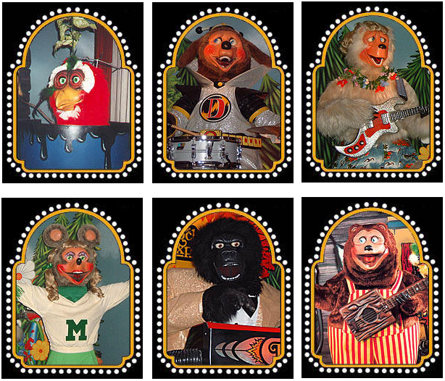

Slide 27

Androids
An android is a robot.
  Not talking about a cellphone
A robot designed to resemble a human, usually both in appearance and behavior.
The word derives from the Greek word meaning "man", and the suffix – “alike”. Basically android means “Like man”.
Robot + Human Likeness = Android

Slide 28
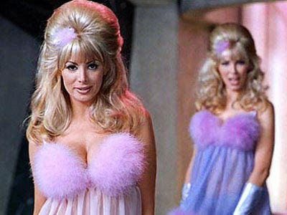
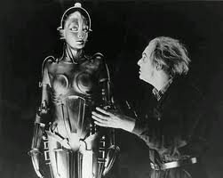
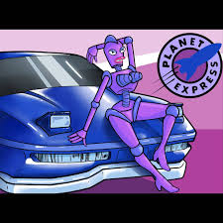

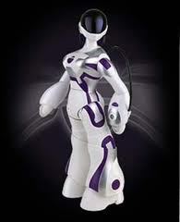
Gynoid
Though the word Android derives from a gender-specific root, its usage in English is usually gender neutral.
The female counterpart, Gynoid, is generally used only when the female gender is a distinguishing trait of the robot.

Slide 29
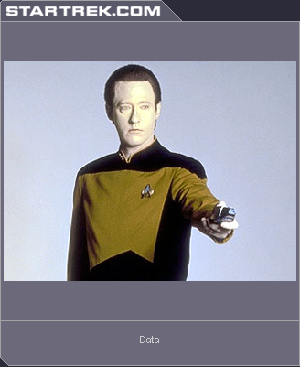
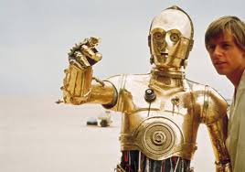
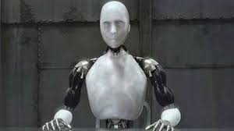

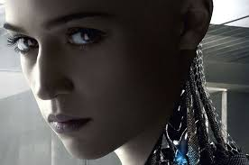
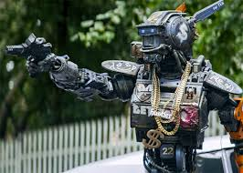
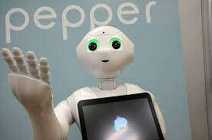
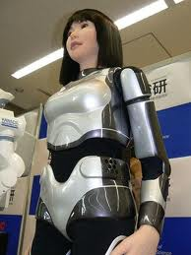
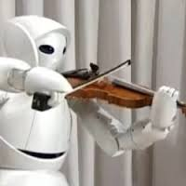
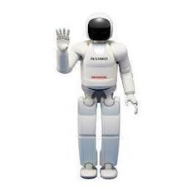
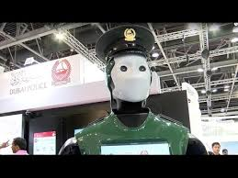
Thus far, androids have largely remained within the domain of science fiction, frequently seen in film and television.
However… The first generation of real Androids are now emerging.

Slide 30
Gray Area, in the Fog, At night (While Dizzy)
The word robot can refer to both physical robots and virtual software agents; however, the latter are usually referred to simply as bots because they have no physical presence and aren’t really Robots in a classical sense.
It gets sort of complicated and there are a lot of gray lines in this area.

Slide 31
One without the other
A robot, or an Android (Being merely a Robot that looks Human) could have Artificial Intelligence built into them giving them intelligence, personality, and make them more personable.
Or
They could have limited programming making them more closely related to sophisticated Automatons.
In either case they would still be considered Robots or Androids (If they look Human…ish).

Slide 32
Robots are Robots regardless as to the operating system that runs their brain,
It can be Artificially Intelligent, or Genuinely Stupid… It’s the physical part that is the Robot (or Android).
but Artificial Intelligence, by itself…
  That’s different… Somehow.

Slide 33
It can be a collection of Hardware that is uniquely “Hard Wired” together, or it can be a program that runs on a more generic type of computer system.
But by itself, it is not a robot.
Not any more than one could say “Windows” is a computer.

Slide 34
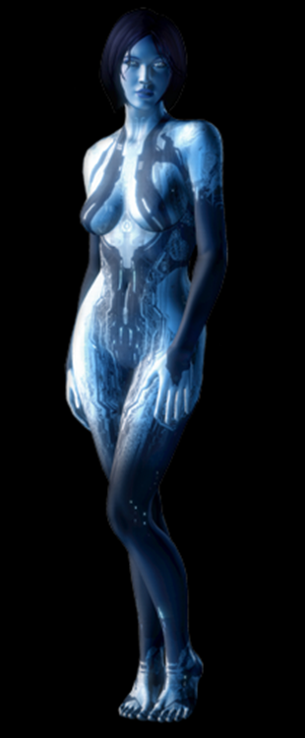
Artificial Intelligence
Cortana is a fictional example of an artificial intelligence in the Halo video game series.
Had the Character Cortana been placed inside of a Robot Body, she could have been considered a “Gynoid”; However, since the character never had more than a holographic projection to represent her, She remains classified as an Artificial Intelligence program.
The character was the inspiration for Microsoft's intelligent personal assistant.

Slide 35

A Robot with built in AI
The Tesla Optimus Robot.
A general-purpose robotic assistant designed to perform tasks that are repetitive, dangerous, or undesirable for humans.
Powered by advanced AI, it can walk, climb stairs, lift and carry objects, as well as manipulate items autonomously

Slide 36

Optimus
Not as advanced as the fictional Cortana, but a big step towards a truly useful Robotic assistant.

Slide 37

"Rosie the Robot" XB-500.

Slide 38
Clone
Cloning is the process of making an identical copy of something.
This could be cloning of anything from a book or software, to a technical or manufacturing process; however, in this context it is referring to an artificial life form.
Basically material is put together in such a way as to produce a life form that is an exact copy of a “master copy” or template.

Slide 39
Make Believe
The clones “In the entertainment universe” are typically manipulated in some manner to increase their usefulness such as accelerated growth to get them to a useful age and physical condition with forced mental training or programming to impart the necessary skills.
Also they usually have some sort of manipulation done to them during the forming process to make them enjoy hard work, or more apt to follow orders with out question.

Slide 40
Harsh Reality
In reality Clones are identical genetic copies of an original made by replacing the DNA of a yet to develop fertilized egg (Zygote) with DNA extracted from another creature.
      Basically making an identical twin for something after it has possibly already grown up and died.
This clone is not the original, It does not have the same memories and feelings, and may not even have the same likes and dislikes.
It is merely identical genetically and therefore prone to be similar to the original.

Slide 41

Dolly the sheep the 1st living clone

Slide 42





Cyborg
A cyborg is a cybernetic organism (an organism that has both artificial and natural systems).
Fictional cyborgs frequently express the difference between human and machine as one concerned with morality, free will, and empathy.
These fictional portrayals often register our society's discomfort with its seemingly increasing reliance upon technology,

Slide 43




In Real life
The cyborg is seen today as an organism that has enhanced abilities due to technology.
“Real cyborgs” are more frequently people who use cybernetic technology to repair or overcome the physical and mental constraints of their bodies, such as from an injury or disability.
Technically they can be classified as a cyborg, but… Non cyborgs tend to be a jealous lot and simply classify such people as “Re-enabled”.
  Maybe they prefer that, its really an individual taste thing.

Slide 44
While cyborgs are commonly thought of as Human based creatures, it is important to realize they don’t necessarily have to be Human.
A cyborg is defined as a cybernetic organism… any kind of Organism.

Slide 45

Technically, This should be called “Cyborg Chicken”!!!

