Slide 1
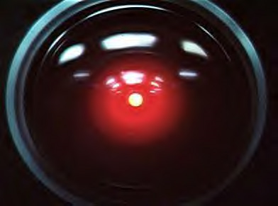
Artificial Intelligence
What is AI?

Slide 2
Artificial intelligence (AI) is the intelligence of machines and the branch of computer science which aims to create it.
Major AI textbooks define the field as "the study and design of intelligent agents," where an intelligent agent is a system that perceives its environment and takes actions which maximize its chances of success.

Slide 3
AI research is highly technical, specialized, and fragmented with one branch seemingly having little to do with another.
Subfields of AI are organized around particular problems, the application of particular tools and around longstanding theoretical differences of opinion.

Slide 4
The whole field of AI is still relatively primitive compared to futuristic fictional works and quite a bit more undeveloped than most people are aware of.
The AI that most people today are exposed to is in the form of Video game programs where the computer component you are battling (or is helping you) has a level of intelligence built in to help make it more challenging, or realistic.
That type of AI is referred to as Built in Intelligence.

Slide 5
Built in Intelligence
Built in Intelligence is the simplest and easiest to understand of all AI.
Basically all possible moves and actions, as well as reactions, are already in the program, and what you do in the game determines the computers response.
This most basic level of Built in Intelligence can be rather mechanical in nature and was the variety used in the earliest games.

Slide 6
More advanced versions can use a random decision generator to vary their response to the same set of conditions, and give more of an appearance of a thought process even when none is actually there.
Further enhancements can be made by having the program analyze all possible moves it can make and mathematically deciding which move will give the best results.
They can even further analyze all your possible moves and calculate all possible countermoves.

Slide 7
Each move is referred to as a ply
The more advanced the system the more ply’s they can project.
In effect this causes you to determine their next move.
This isn’t really a form of intelligence but more of a formula.
The only real intelligence involved is in the making of the formula, but in the end the game itself is not really intelligent.

Slide 8
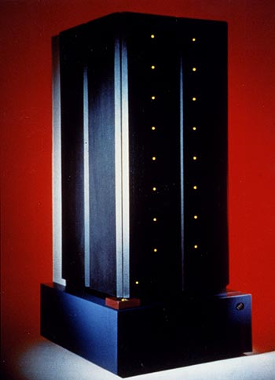
IBM - Deep Blue
The Deep Blue chess computer which defeated Kasparov in 1997 would typically search to a depth of between six and sixteen ply and up to a maximum of forty ply in some situations.

Slide 9
Fuzzy Logic
In mathematics, a form of logic based on the concept of a fuzzy set.
Membership in fuzzy sets is expressed in degrees of truth.
In a narrow sense, the term fuzzy logic refers to a system of approximate reasoning with unclear, or “fuzzy,” boundaries.

Slide 10


Fuzzy sets
Membership in a fuzzy set may be indicated by any number from 0 to 1, representing a range from “definitely not in the set” through “partially in the set” to “completely in the set.”
For example, at age 45 a man is neither very young nor very old Depending on your perspective.
This makes it difficult in traditional logic to say whether or not he belongs to the set of “old persons.”
Clearly he is “sort of” old, but can probably still hit hard enough to not be called it to his face.
This is basically a qualitative assessment that can be quantified by assigning a value, or degree of membership.
Say 0.54—for his inclusion in a fuzzy set of old persons where 0 is young, and 1 is Old.

Slide 11
Outside variables can influence this.
For example if you are talking about Football players 45 might be considered way old.
But if you are talking about Congressmen… Then 45 would be considered quite young.

Slide 12


Slide 13
Artificial neural Networks
An artificial neural network is a system based on the operation of biological neural networks.
Artificial neural networks emerged after the introduction of simplified neurons by McCulloch and Pitts in 1943.

Slide 14
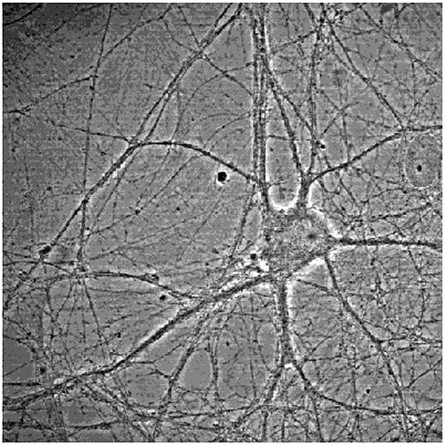

Slide 15
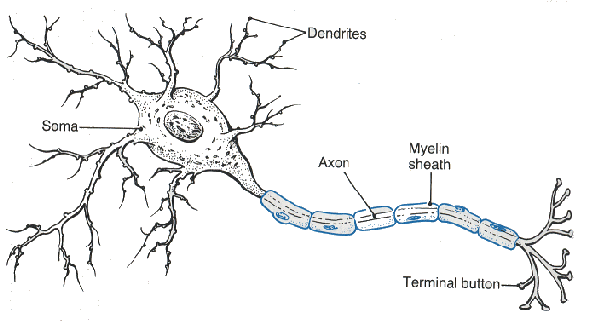
The Neuron
Cell Body – Called the Soma (Contains the Nucleus.)
Dendrites - Radiate out from the Cell body and receive signals from other neurons.
Axon – Basically the transmitter line that sends signals out of the cell (Insulated with the myelin sheath).
The Axon ends in branches that terminate in Terminal Buttons.
The terminal button of one neuron separated by a small cleft or gap from the Dendrite of another cell makes a synapse.

Slide 16
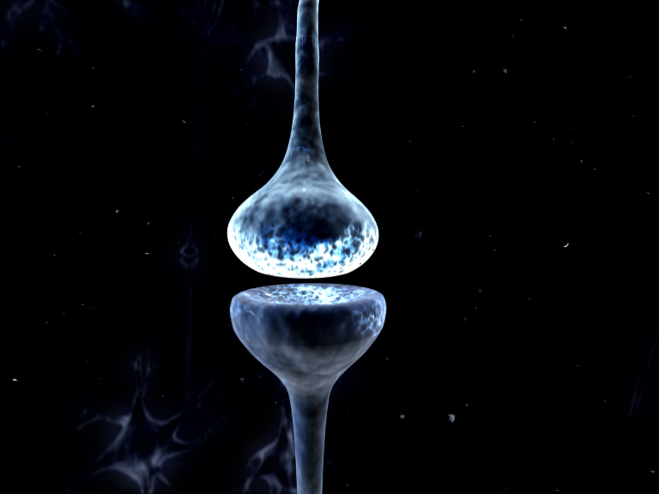
Synapse
Classically a firing synapse is represented with a spark of electricity arcing across it, but in reality it is a complex process of chemical movements.
The terminal buttons send out chemicals as signals that are received on the surface of the dendrites. Once the signal has been received, the chemicals are reabsorbed by the Terminal buttons, essentially unplugging them from the dendrites and ending the signal transmission.
Dopamine is one of the chemical messengers that are used to transmit signals across the synapse.
Dopamine is associated with pleasure and movement.

Slide 17
Cocaine and the Synapse
Cocaine is a strong stimulant that interferes with the reabsorption process of dopamine.
This interference leads to increased dopamine presence on the dendrites and chronic stimulation of dopamine receptors.
This results in an intense euphoric ‘rush’ and heightened feelings of pleasure.

Slide 18
Heroin and the Synapse
Heroin causes the brain to produce dopamine.
Heroin is a trigger that causes the overproduction of dopamine.
When the reabsorption process removes the dopamine from the dendrites it is instantly replaced with another dopamine molecule causing chronic stimulation of the receptors.

Slide 19
Methamphetamine and the Synapse
Meth uses both mechanisms to create a chronic stimulation of the dopamine receptors.
It stimulates overproduction of dopamine while at the same time inhibits reabsorption.
The dopamine receptors are literally flooded with dopamine.
This results in an even more intense and longer lasting feelings of pleasure.

Slide 20
The end result of Drugs and the Synapse
The synapses of the brain can not maintain prolonged dopamine stimulation.
With such a overwhelming stampede of dopamine the brain reacts in a similar way a crowd is controlled in a building… The doors are shut to keep them out.
The Neuron shuts its doors by shutting down dopamine receptors until the pleasure stimulation is back to normal levels.

Slide 21
Unfortunately the Neurons were not equipped with the ability to simply shut down the receptors.
It has to destroy them.
Once destroyed, they can never be rebuilt.
With reduced dopamine receptors Drug users quickly reach a point where they have to continue taking more and more of the drugs in order to simply feel normal.
Without it… Uncontrollable and intolerable depression results.

Slide 22
So in the end…
The “Rush” of pleasure drug users feel is not simply extra pleasure…
Its their future pleasure that they are gobbling up today, leaving none left for tomorrow.
Sadness and depression is their only future and it happens way sooner than they realize as receptor destruction starts with the first use.

Slide 23
How the Neuron works
The dendrites receive the input from another neuron across the Synapse.
The signal travels down the dendrite to the cell body (Soma).
The signal is altered along this path. It is either reduced, or amplified.
The dendrites connect the cell to many other Cells and receive many signals at different times and in different combinations.
The cell collects all these separate signals and sum's them together into one big signal.
If this one big signal is larger than the threshold of the cell then it will cause the cell to fire a signal down its axon and on to the next cells.

Slide 24
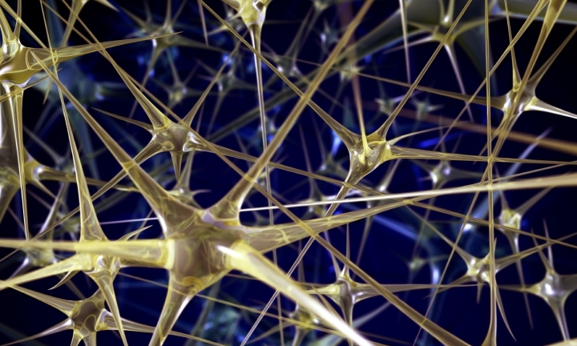
Each cell receives signals from many other cells through its branching Dendrites.
Each cell sends its signal on to many other cells through its axon that end by branching out to many others.

Slide 25

Rat Brain!

Slide 26


Slide 27
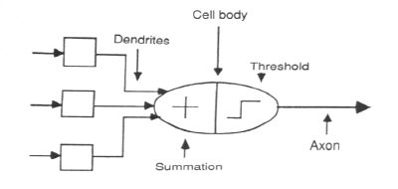
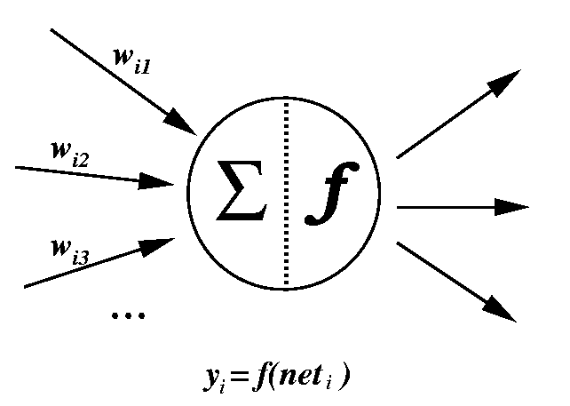
The Artificial Neuron
A couple of examples:

Slide 28
The Artificial Network
The neurons are combined into a network of interconnections.
This usually is comprised of several layers of neurons.
The first two layers are sort of intuitive: They are located on the outside and are the input layer and the output layer.
Between these layers there are one or more Hidden layers (Depending on how complex the network is) .

Slide 29
The basic rules are simple:
The output of every neuron needs to connect to the input of every cell in the next layer.

Slide 30
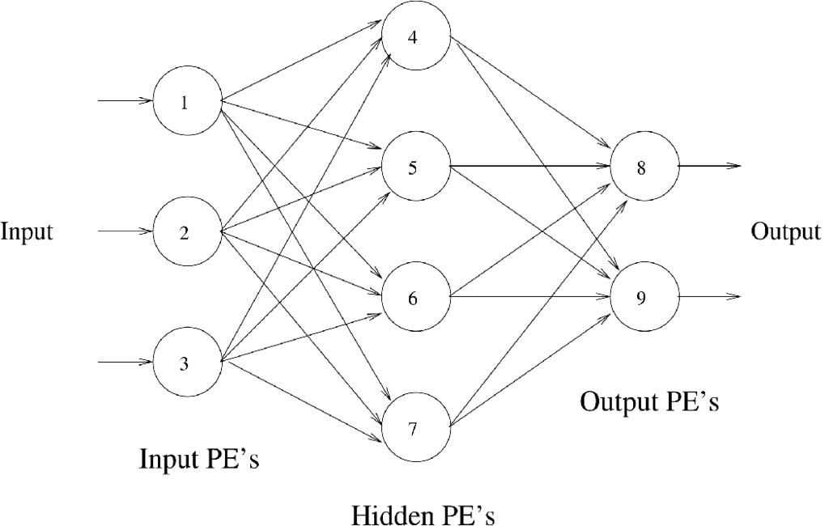
A simple ANN

Slide 31
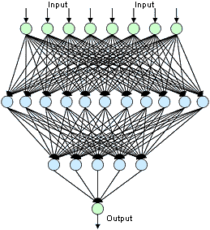
It can get somewhat complex

Slide 32
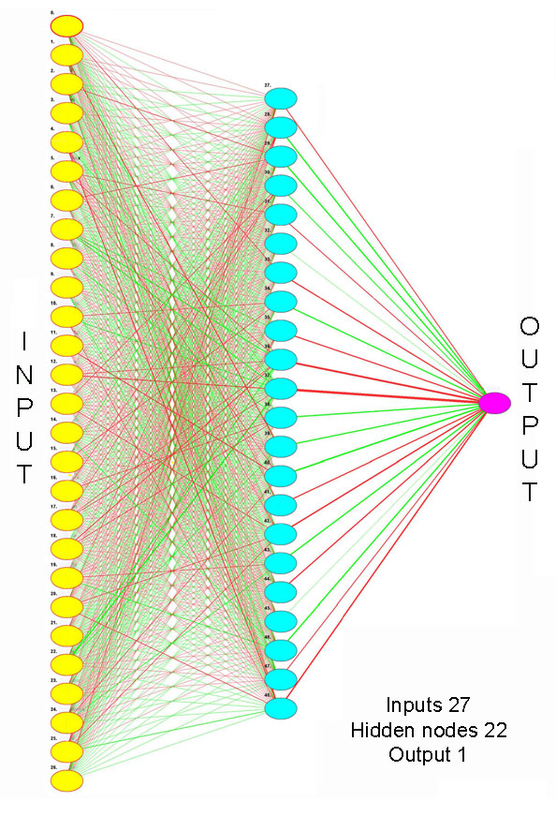

Slide 33
The logic of the network is controlled by the weighting of the dendrites.
Basically the signal pathways are altered to change the output.
There is a lot more to it than this, but… This is only an introductory course.

Slide 34
Strong AI
Artificial intelligence that matches or exceeds human intelligence.
The intelligence of a machine that can successfully perform any intellectual task that a human being can.
Science fiction, associates strong AI with such human traits as consciousness, sentience, sapience and self-awareness.

Slide 35
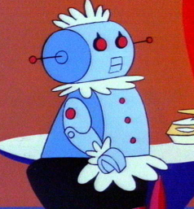
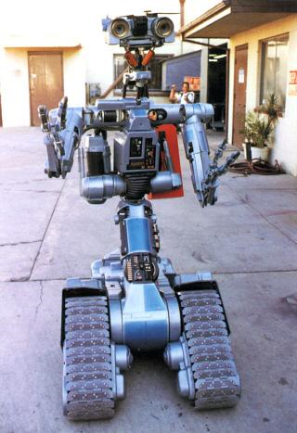

General intelligence (or "strong AI") is still a long term goal of (some) research.

