Slide 1
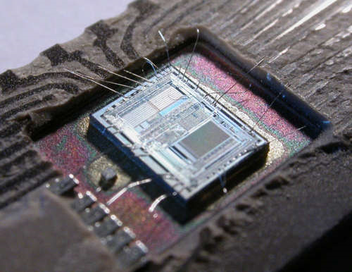
What is a Microcontroller?
Electronic control
and
control of electronics.

Slide 2

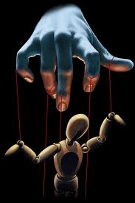
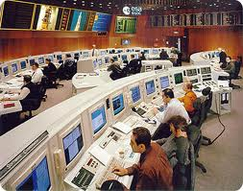
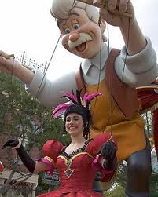
To understand what a microcontroller is you must first understand control.

Slide 3
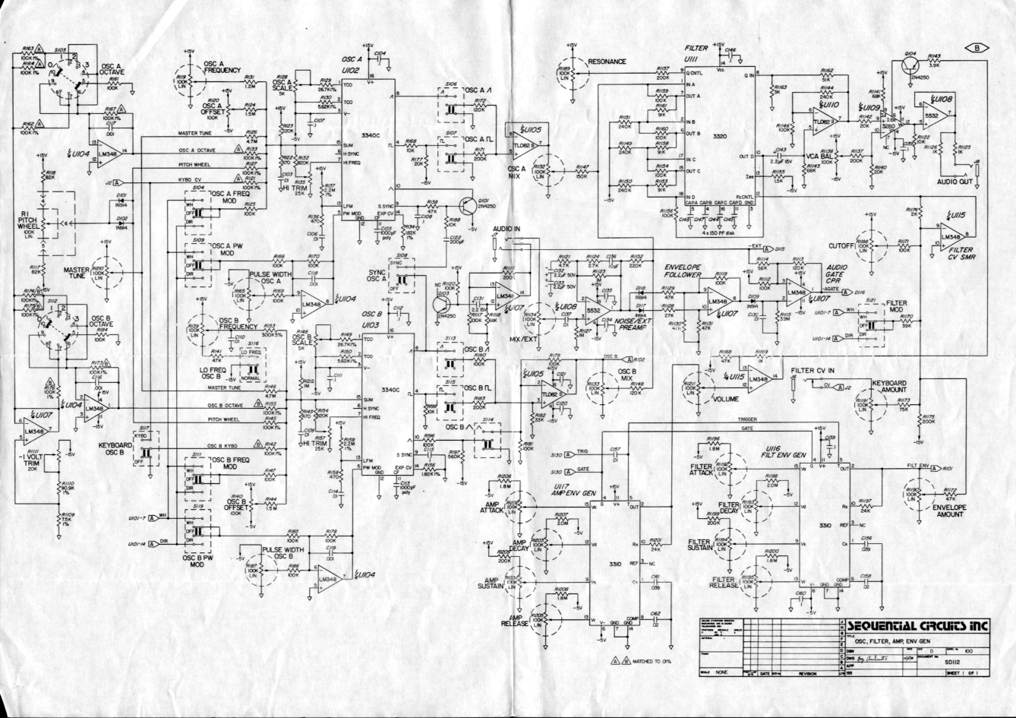
Electronics are, in the simplest of terms, nothing more than a collection of electronic components arranged into circuits and systems to accomplish a task of some sort.

Slide 4
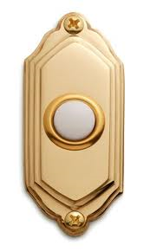
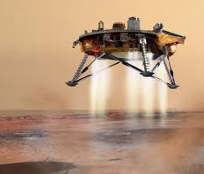
These tasks can range wildly in purpose from something as simple as sounding a chime or buzzer when someone pushes a button (Doorbell) or can be as complicated as the guidance system on a probe sent to Mars.

Slide 5
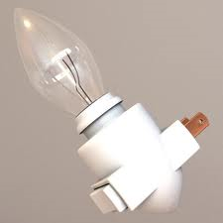
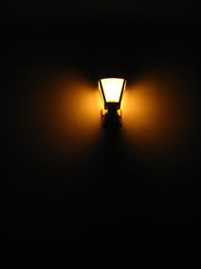
Some devices do not require any real control at all.
They are either on, or they are not on, and if they function at all they are often just left on all the time.

Slide 6

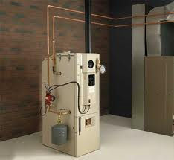
Other devices require alteration of some kind with changing conditions.
A simple example of such could be a can opener.
It runs when activated, but is not needed, nor is it desired, to have it run constantly.
It is manually controlled.
A slightly more complicated example would be a home heating/air conditioning system.
It turns on and off automatically as the temperature changes, basically regulating its own actions depending on the conditions.

Slide 7
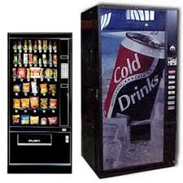
A more complicated example would be a vending machine.
You activate it, tell it your selection and it delivers the product through a sometimes rather complicated process.
This can require many steps to complete.

Slide 8
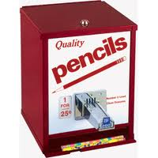
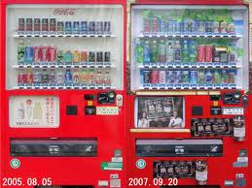
This can be a simple mechanical process…
Or a complex electronically controlled one.

Slide 9
Control
Lets break this down to its basics.
Control can be:
  Manual or Automatic
  Mechanical or Electronic
  It can also be Simple or Complex
  Be careful here as this is subjective.
  What may look complex ends up being rather simple in comparison to other control schemes.

Slide 10
Side note
The line can become blurred between the electronic and mechanical systems as they are heavily interdependent and interconnected on some systems.
Is an electrical motor a mechanical or an electrical device?
  It is both and is referred to as an electromechanical device.
The term Mechatronics is defined as a multidisciplinary engineering system.
  In other words, it is the synergistic combination of Mechanical, Electronic, Control, Computer, and Systems Design engineering.

Slide 11
Relay Logic
Relay Logic is applied when the control of a system is built into it (Hardwired in).
A line can have a timer controlled relay that when a button is pushed activates something and after a short time the relay disconnects it automatically.
A group of relays can be used to activate a series of different circuits in a certain order setting up a series of events that happen in a predetermined order.
They can also be used to control conditions of operation.
  Such as, not being able to turn on a machine if a door is left open.

Slide 12
Relay Logic is effective and proven, but not always practical due to size, power consumption, wear of components and the inability to easily make changes.
It is still used, and remains an effective control scheme, but as the complexity of the control increases a more advanced type of scheme is needed.

Slide 13
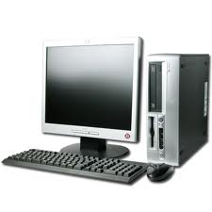
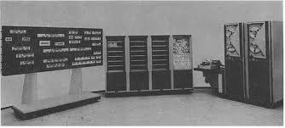
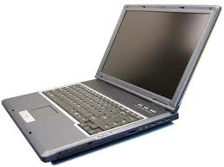
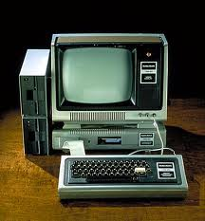
Computer Control
A computer system can be used to control complex electronic systems.
Computers tend to be able to supply vast control needs with relative ease and flexibility.
They in themselves are based on logic design and are internally controlling themselves in the same manor as they control outside circuits, and using them to do so simply extends their internal architecture to outside circuits.

Slide 14


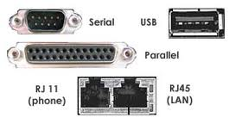
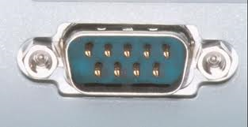
Computers have input lines to receive data.
  An example:
    A light sensor that sends a signal to the computer when it senses light letting the PC know it is not cloudy outside.
    A moisture sensor that sends a value to the computer letting it know how dry the soil is outside in the yard.
    A Rain sensor letting the PC know that it is not raining.
    A motion or presence sensor letting the PC know that there is no one standing on the front lawn at this time.

Slide 15
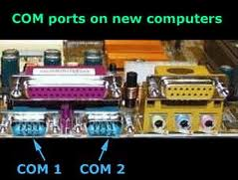
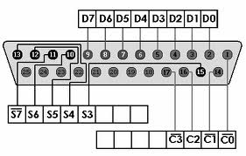
Computers also have output lines to send out data, or control outside circuits.
  It can send a signal and activate the a sprinkler system.
  It can turn on or off lights.
  It can lock or unlock doors.
  It can turn on coffee pots or even place a call using its modem.

Slide 16

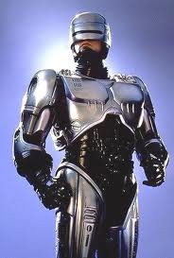
The Computer uses a set of instructions programmed into it to decide what to do giving a set of conditions.
If the computer is so programmed it will turn on the sprinkler system if:
  The soil is dry.
  No one is on the lawn.
  It is not raining.
Likewise, if so programmed the computer will call the police if it detects someone standing on the lawn at a certain time of day.

Slide 17
Lets say you have a PC controlling your sprinkler system.
Its dedicated to turning on and off the water when certain conditions are met and you never have to worry about watering the lawn again!
But that is all this computer does, and is all it will ever do.
There is no reason to have solitaire, or minesweeper loaded on it is there?
In fact there are several things you would probably never need on it, such as a monitor or keyboard or mouse so long as the program loaded and started running as soon as it was booted.
Further more you wouldn’t need a lot of memory, a CD ROM, a sound card and any number of other devices.
As a mater of fact if you striped the PC down to the essential items you could build the sprinkler control system more dependably and more economically allowing you to either pass the savings on to a costumer, or sell it for the same price and make more money!!!
This is what home security systems do… They are basically a striped down, bare bones, dedicated computer that has a set of sensors tied to them to monitor certain conditions when activated and they use their modems to call the monitoring office when the sensors are activated.

Slide 18
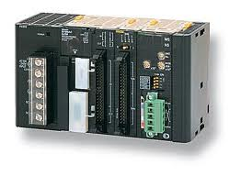
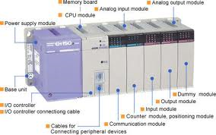
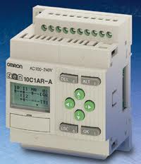
Programmable Logic Controller
A PLC is essentially a striped down, bare bones, dedicated computer.
Some of them are modular so you can expand them to customize them for different applications.
There are many types and they come in a variety of capabilities and configurations.

Slide 19
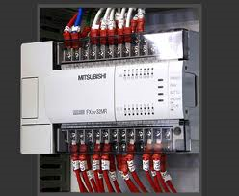
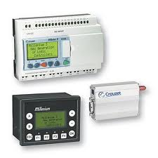
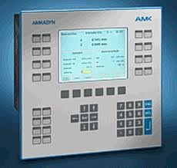
The modular units have discrete sub systems:
  a separate power supply module.
  additional input modules to expand the amount of input devices attached.
  Additional output modules to expand the amount of devices the system can control.
  Modems.
  Memory modules to allow it to hold bigger programs.
They are the standard device used to control industrial machinery and many industrial robots, and you can mix and match their modules to meet the equipment control needs.

Slide 20
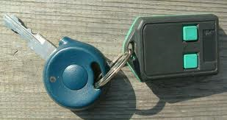
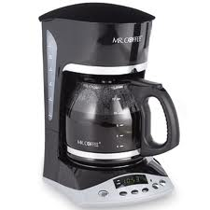
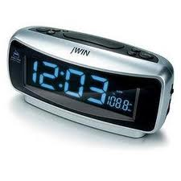
Microcontroller
You have probably already used several microcontrollers today even if you are unaware of them.
They are used in alarm clocks, cell phones, coffee makers, and automobiles to name a few.

Slide 21
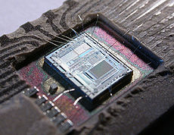
A microcontroller is a small computer on a single chip.
This chip containing a processor core, memory, and programmable input/output lines.
Microcontrollers are designed for “embedded applications”, that is, applications that they are dedicated to performing and never anything more.

Slide 22
A microcontroller chip including any of its support hardware (such as voltage regulators, clock pulse generators and the like) are referred to as an embedded computer system.
This system can be mounted on its own small pc board, and if the components are small surface mount devices the entire system can end up looking like a large microchip itself, even though it consists of several discrete microchips.
Often the whole system is just referred to as the microcontroller even though it is just the chip that is the actual microcontroller.

Slide 23
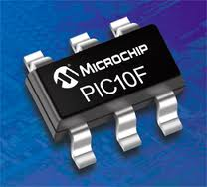
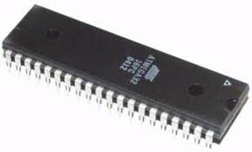
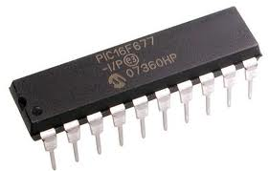
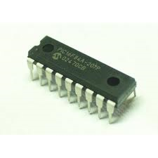
Programmable Interface Controller (PIC)
The PIC is a family of microcontrollers made by Microchip Technology.
PICs are popular due to their low cost, wide availability, large user base, extensive collection of application notes, availability of low cost or free development tools, and serial programming (and re-programming with flash memory) capability.

Slide 24
A PIC (Depending on the type and size) range from about $0.30 - $5.00 each.
Rather design a circuit using 4 or 5 Logic chips to accomplish a task many company’s just use a simple PIC and program it to do the same thing.
At $0.35 each this can be cheaper and even if it ends up being slightly more expensive it simplifies the manufacturing process and in the long run that can drive prices down.

Slide 25
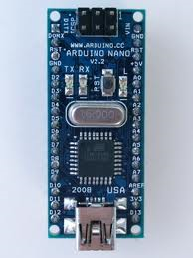
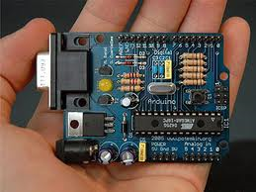
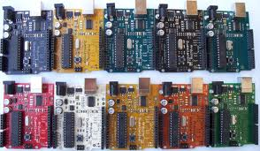
Arduino
The Arduino is a complete embedded computer system (Microcontroller) that includes all the necessary support hardware already put on a PC board.
It comes in different sizes and configurations, but they are all basically the same unit despite the differences in packaging.

Slide 26
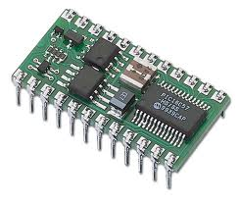
The Basic Stamp
The Basic stamp is similar to the Arduino in that it is a complete embedded computer system (Microcontroller) that includes all the necessary support hardware already put on a PC board.
It contains a PIC16C57 microcontroller, a 5V voltage regulator, a timing pulse generator, extra ram memory to support the PIC, as well as other necessary hardware to make the unit function.

